Slide 1
Module 20: Introduction to the ASA
Instructor Materials
Networking Security v1.0
(NETSEC)
Notes:
Networking Security (NETSEC) Module 20: Introduction to the ASA

Slide 2
Module Objectives
Module Title: Introduction to the ASA
Module Objective: Explain how the ASA operates as an advanced stateful firewall.
Topic Title | Topic Objective
ASA Solutions | Compare ASA solutions to other routing firewall technologies.
The ASA 5506-X with FirePOWER Services | Describe three ASA deployment scenarios.
Notes:
2
20 – Introduction to the ASA
20.0.2 – What will I learn to do in this module?

Slide 3
20.1 ASA Solutions
Notes:
20: Introduction to the ASA 20.1: ASA Solutions

Slide 4
ASA Solutions
ASA Firewall Models
The Cisco ASA with FirePOWER Services family of products provides dedicated firewall services in one device. These are next-generation firewall (NGFW) devices that deliver integrated threat defense across the entire attack continuum. They combine proven ASA firewalls with Sourcefire threat and advanced malware protection in a single device. These include Cisco Firepower 1000, Cisco Firepower 2100, Cisco Firepower 4100, Cisco Firepower 9300. All models provide advanced stateful firewall features and VPN functionality. The biggest difference between the models is the maximum traffic throughput handled by each model and the number and types of interfaces.
Cisco also supports the virtualization of computing infrastructure by taking advantage of the increased power availability of modern x86 servers. The Cisco Adaptive Security Virtual Appliance (ASAv) brings the power of ASA appliances to the virtual domain.
To provide a suitable fit for customer needs, Cisco ASAv is available in five models: Cisco ASAv5, Cisco ASAv10, Cisco ASAv30, Cisco ASAv50, Cisco ASAv100. The focus of this module will be on the ASA 5506-X which is designed for small business, branch office, and enterprise teleworker implementations.
Notes:
20: Introduction to the ASA 20.1: ASA Solutions 20.1.1: ASA Firewall Models

Slide 5
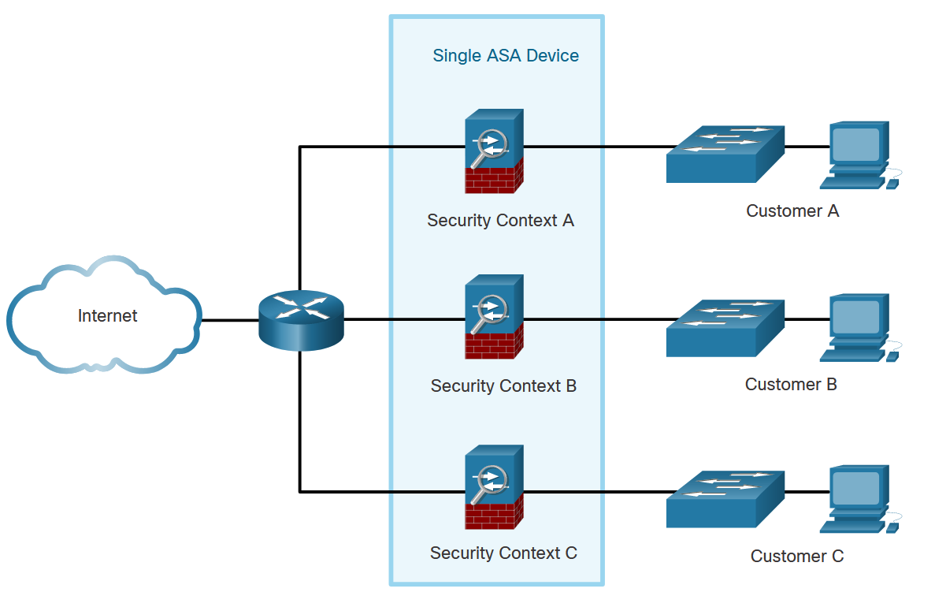
ASA Solutions
Advanced ASA Firewall Features
A single ASA can be partitioned into multiple virtual devices, as illustrated here. Each virtual device is called a security context. Each context is an independent device, with its own security policy, interfaces, and administrators. Multiple contexts are similar to having multiple standalone devices. Many features are supported in multiple context modes, including routing tables, firewall features, IPS, and management. Some features are not supported, including VPN and dynamic routing protocols.
Notes:
20: Introduction to the ASA 20.1: ASA Solutions 20.1.3: Advanced ASA Firewall Features

Slide 6
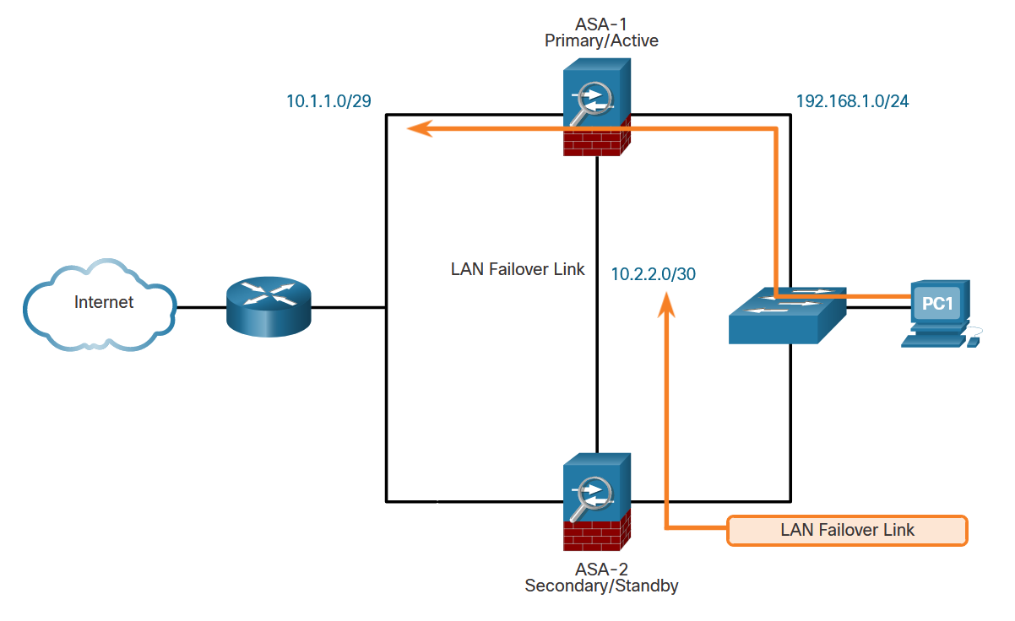
ASA Solutions
Advanced ASA Firewall Features (Cont.)
As shown here, two identical ASAs can be paired into an active / standby failover configuration to provide device redundancy. Both platforms must be identical in software, licensing, memory, and interfaces, including the Security Services Module (SSM). In the example, ASA-1 is the primary/active forwarding device and traffic leaving PC-1 takes the preferred path using ASA-1. ASA-1 and ASA-2 monitor each other using the LAN failover link. If ASA-1 fails, then ASA-2 would immediately assume the primary role and become active.
Notes:
20: Introduction to the ASA 20.1: ASA Solutions 20.1.3: Advanced ASA Firewall Features

Slide 7
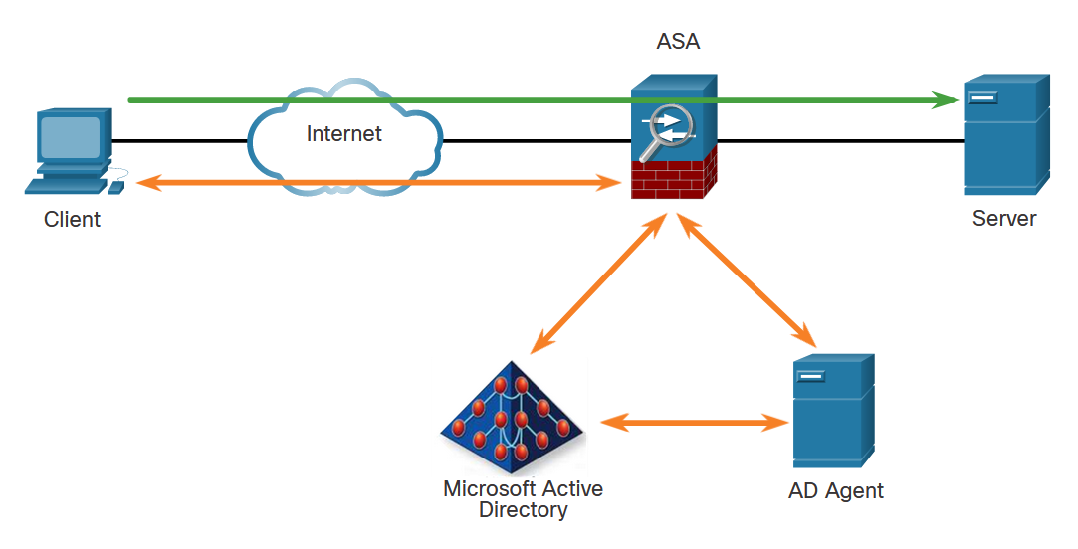
ASA Solutions
Advanced ASA Firewall Features (Cont.)
The ASA provides optional, granular access control based on an association of IP addresses to Windows Active Directory login information. For example, in the figure, when a client attempts to access the server resources, it must first be authenticated using the Microsoft Active Directory Identity-based firewall services. These services enhance the existing access control and security policy mechanisms by allowing users, or groups, to be specified in place of source IP addresses. Identity-based security policies can be interleaved without restriction between traditional IP address-based rules.
Notes:
20: Introduction to the ASA 20.1: ASA Solutions 20.1.3: Advanced ASA Firewall Features

Slide 8
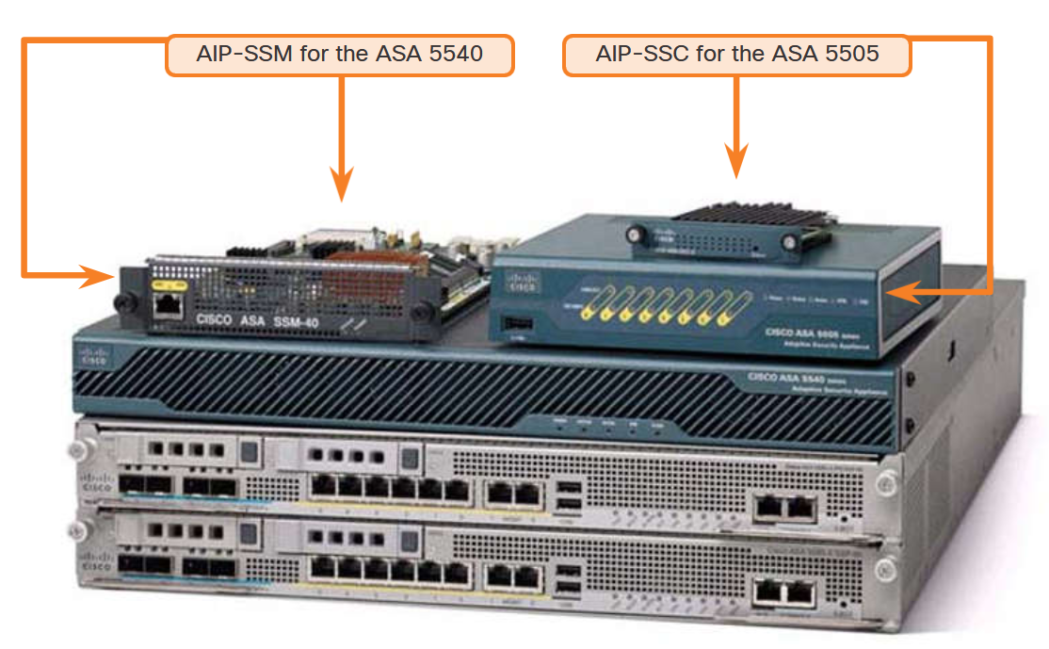
ASA Solutions
Advanced ASA Firewall Features (Cont.)
The ASA uses the Advanced Inspection and Prevention (AIP) modules. Antimalware capabilities can be deployed by integrating the Content Security and Control (CSC) module. The Cisco Advanced Inspection and Prevention Security Services Module (AIP-SSM) and Cisco Advanced Inspection and Prevention Security Services Card (AIP-SSC) deliver protection against tens of thousands of known exploits.
Notes:
20: Introduction to the ASA 20.1: ASA Solutions 20.1.3: Advanced ASA Firewall Features

Slide 9
ASA Solutions
Cisco Firepower Series
Cisco has introduced a new line of next-generation firewalls (NGFW) which combines their proven firewall technology with Sourcefire advanced threat and malware detection capabilities.
These NGFWs consolidate multiple security layers into a single platform, eliminating the cost of buying and managing multiple solutions. This integrated approach combines best-in-class security technology with multilayer protection that is integrated into a single device.
The Cisco ASA 5500-X with FirePOWER Services devices are part of the new Cisco NGFWs. Designed for small to medium branch offices, the ASA 5500-X with FirePOWER Services merges the ASA 5500 stateful firewall features with some of the following advanced threat and malware detection capabilities:
Next-generation IPS (NGIPS)
Advanced Malware Protection (AMP)
Application control and URL filtering
Notes:
20: Introduction to the ASA 20.1: ASA Solutions 20.1.4: Cisco Firepower Series

Slide 10
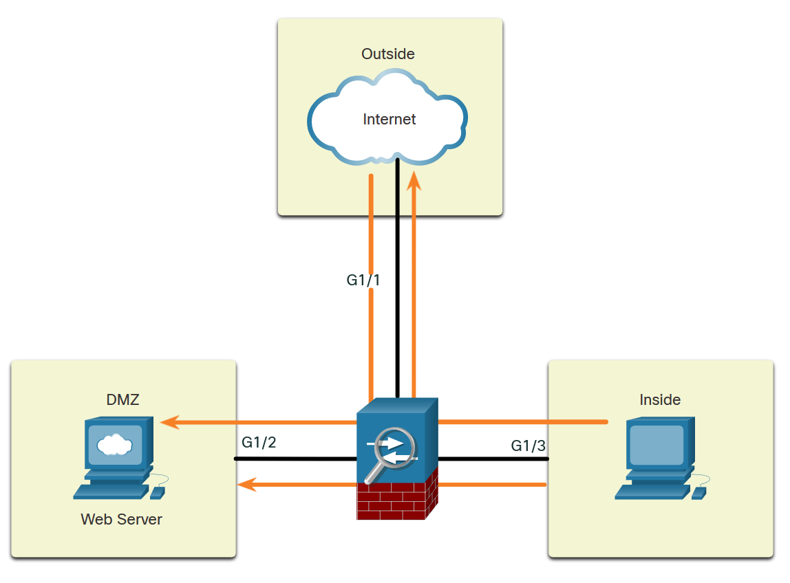
ASA Solutions
Review of Firewalls in Network Design
When discussing networks that are connected to a firewall, there are some general terms to consider:
Outside network - The network/zone that is outside the protection of the firewall.
Inside network - The network/zone that is protected and behind the firewall.
DMZ - The demilitarized zone that allows both inside and outside users access to protected network resources.
Firewalls protect inside networks from unauthorized access by users who are on an outside network. They also protect inside network users from each other. For example, by creating zones, an administrator can keep the network that is hosting the accounting servers separate from other networks in an organization.
The figure illustrates how these zones interact for permitted traffic:
Traffic originating from the inside network going to the outside network is permitted.
Traffic originating from the inside network going to the DMZ network is permitted.
Traffic originating from the outside network going to the DMZ network is selectively permitted.
Notes:
20: Introduction to the ASA 20.1: ASA Solutions 20.1.6: Review of Firewalls in Network Design

Slide 11
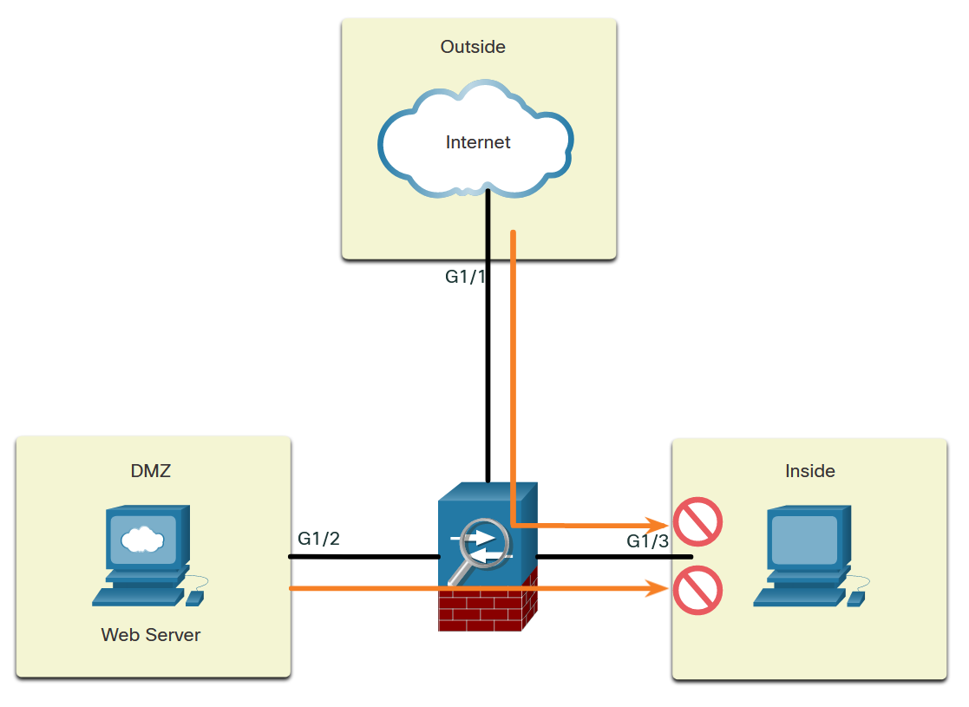
ASA Solutions
Review of Firewalls in Network Design (Cont.)
The figure illustrates how these zones interact for denied traffic:
Traffic originating from the outside network going to the inside network is denied.
Traffic originating from the DMZ network going to the inside network is denied.
Cisco ISRs can provide firewall features by using either the Zone-Based Policy Firewall (ZPF) or by using the older context-based access control (CBAC) feature.
Notes:
20: Introduction to the ASA 20.1: ASA Solutions 20.1.7: ASA Firewall Modes of Operation

Slide 12
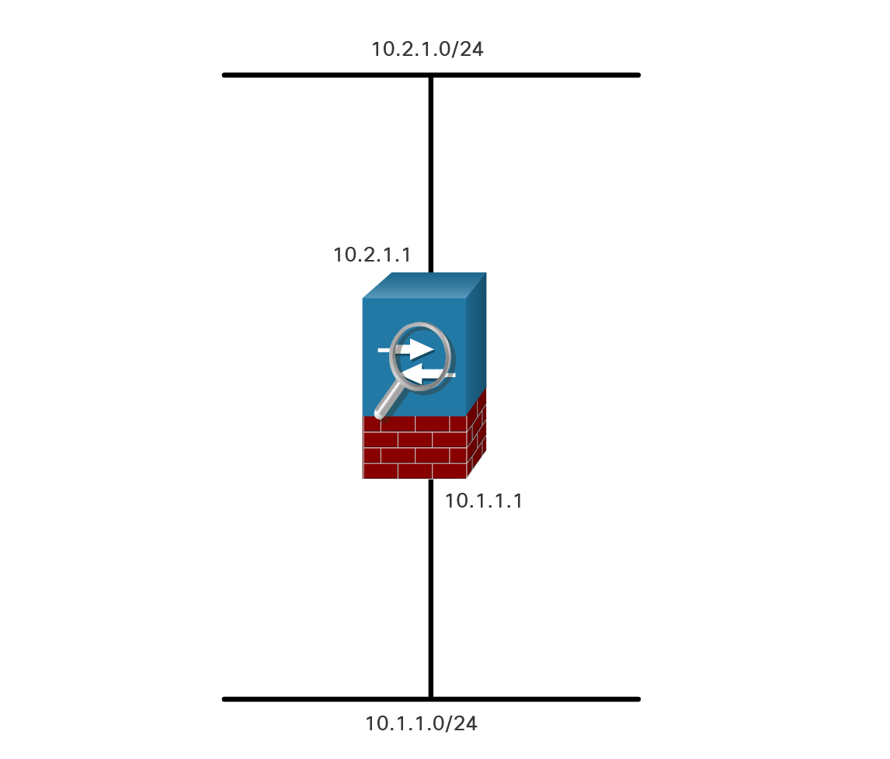
ASA Solutions
ASA Firewall Modes of Operation
Routed Mode
There are two firewall interface modes of operation available on ASA devices: routed mode and transparent mode.
In routed mode, two or more interfaces separate Layer 3 networks, i.e. domains.
In the figure, the ASA is considered to be a router hop in the network and can perform NAT between connected networks. Routed mode supports multiple interfaces. Each interface is on a different subnet and requires an IP address on that subnet. The ASA applies policies to flows as they transit the firewall.
Notes:
20: Introduction to the ASA 20.1: ASA Solutions 20.1.7: ASA Firewall Modes of Operation

Slide 13
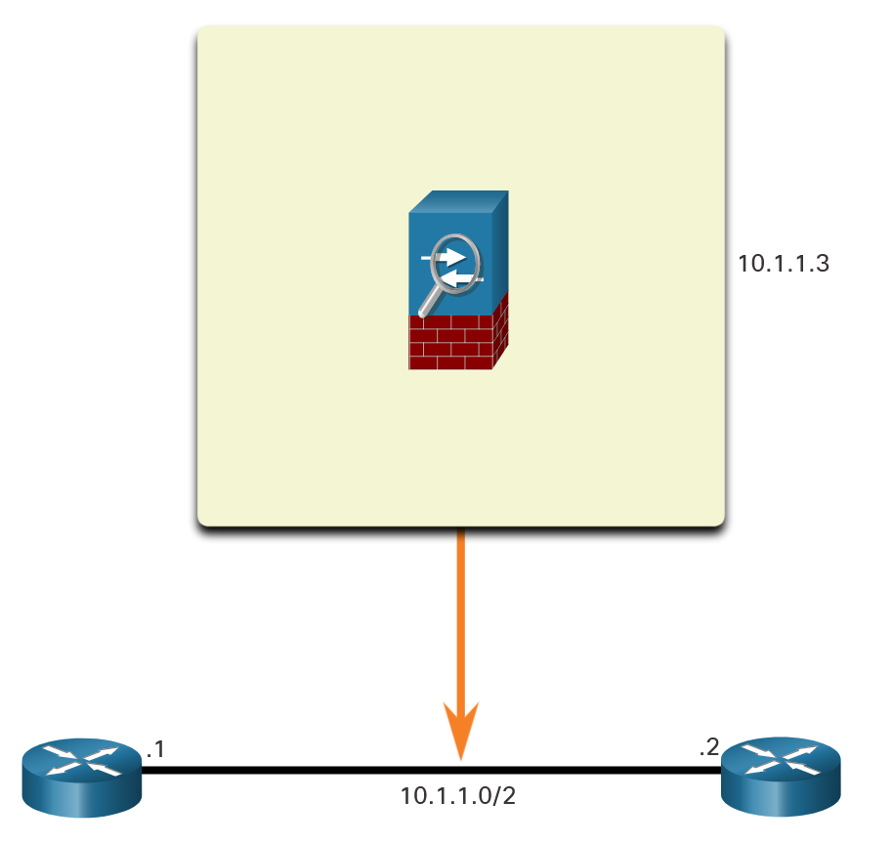
ASA Solutions
ASA Firewall Modes of Operation (Cont.)
Transparent Mode
An ASA in transparent mode is often referred to as a “bump in the wire,” or a “stealth firewall” because the ASA functions like a Layer 2 device and is not considered a router hop. In the figure below, the ASA is only assigned an IP address on the local network for management purposes. This mode is useful to simplify a network configuration, or when the existing IP addressing cannot be altered. However, the drawbacks include no support for dynamic routing protocols, VPNs, QoS, or DHCP Relay.
Notes:
20: Introduction to the ASA 20.1: ASA Solutions 20.1.7: ASA Firewall Modes of Operation

Slide 14
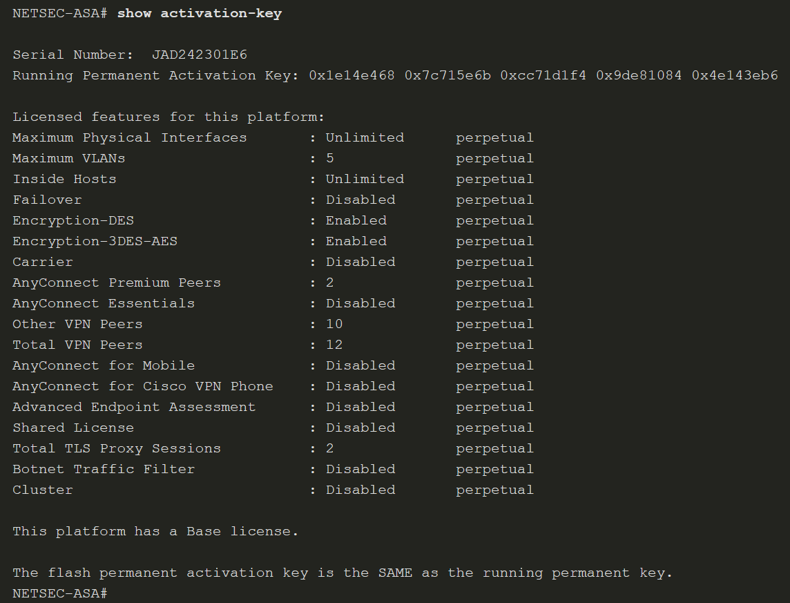
ASA Solutions
ASA Licensing Requirements
A license specifies the options that are enabled on a given ASA. Most ASA appliances come pre-installed with either a Base license or a Security Plus license.
To provide more features to the ASA, additional time-based or optional licenses can be purchased.
To verify the license information on an ASA device, use the show activation-key command, as shown below, or the show version command.
Notes:
20: Introduction to the ASA 20.1: ASA Solutions 20.1.8: ASA Licensing Requirements

Slide 15
20.2 The ASA 5506-X with FirePOWER Services
Notes:
20: Introduction to the ASA 20.2: The ASA 5506-X with FirePOWER Services

Slide 16
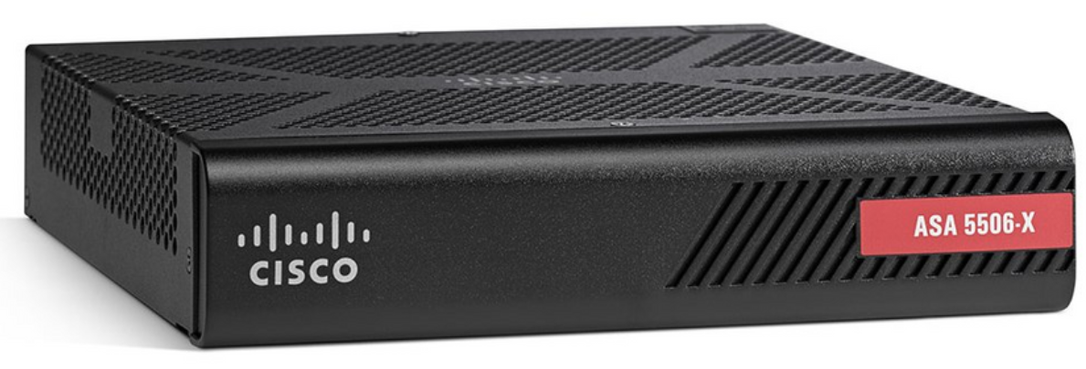
The ASA 5506-X with FirePOWER Services
Overview of ASA 5506-X
The Cisco ASA 5506-X delivers a high-performance firewall, SSL VPN, IPsec VPN, and rich networking services in a modular, plug-and-play appliance. The default DRAM memory is 4 GB and the default internal flash memory is 8 GB. In a failover configuration, the two units must be identical models with the same hardware configuration, the same number and types of interfaces, and the same amount of RAM. Failover is available with the Security Plus license.
The figure illustrates the front panel of the ASA 5506-X.
Notes:
20: Introduction to the ASA 20.2: The ASA 5506-X with FirePOWER Services 20.2.1: Overview of ASA 5506-X

Slide 17
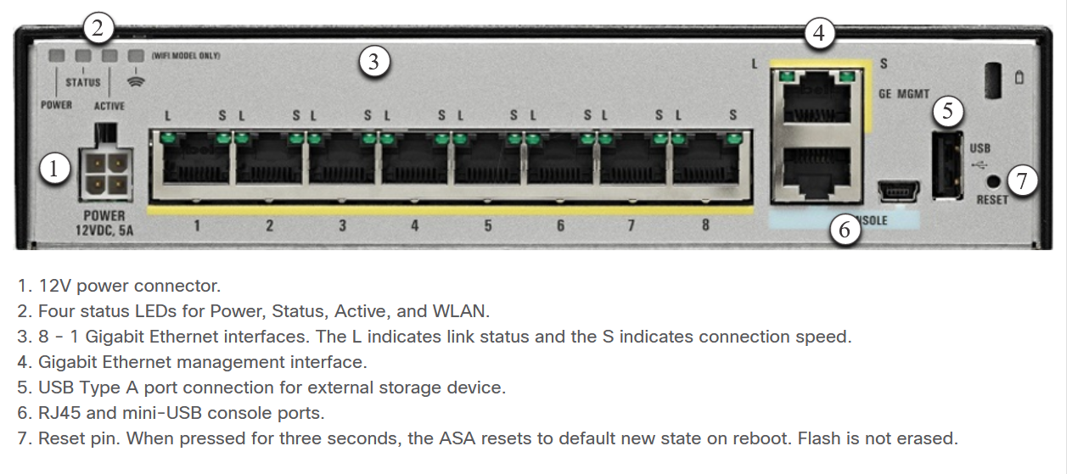
The ASA 5506-X with FirePOWER Services
Overview of ASA 5506-X
The figure illustrates the back panel of the Cisco ASA 5506-X.
Notes:
20: Introduction to the ASA 20.2: The ASA 5506-X with FirePOWER Services 20.2.1: Overview of ASA 5506-X

Slide 18
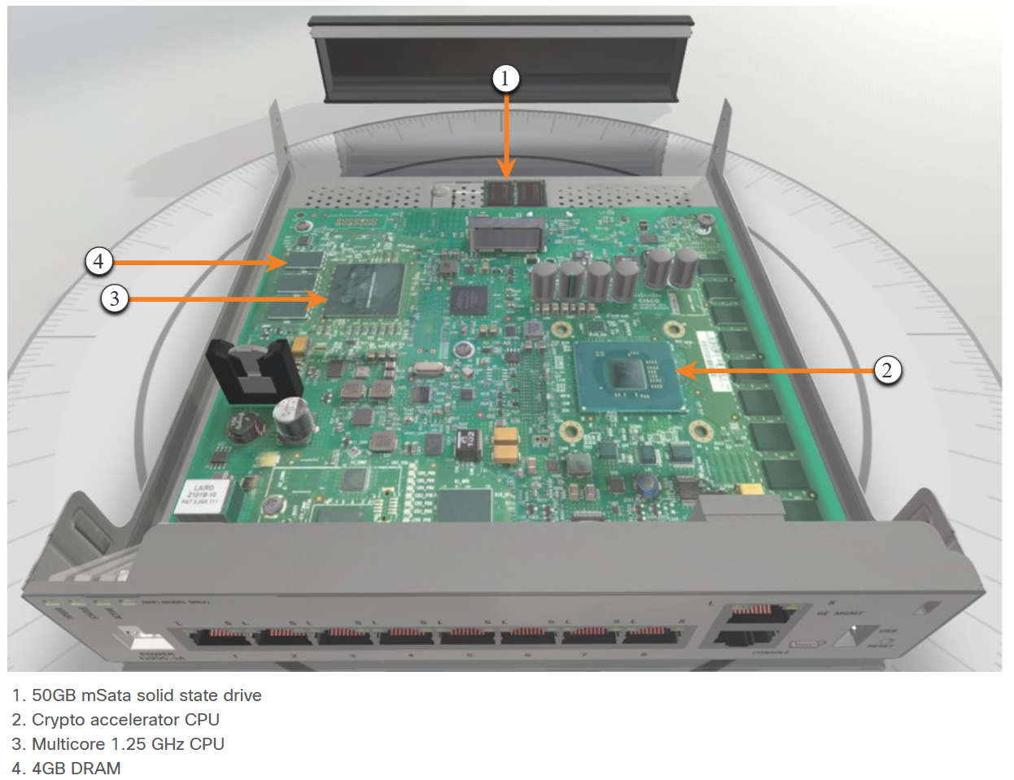
The ASA 5506-X with FirePOWER Services
Overview of ASA 5506-X (Cont.)
The figure shows the inside components of the Cisco ASA 5506-X.
Unlike the ASA 5505, the ASA 5506-X does not use switchports. All interfaces are routed and require IP addresses.
Notes:
20: Introduction to the ASA 20.2: The ASA 5506-X with FirePOWER Services 20.2.1: Overview of ASA 5506-X

Slide 19
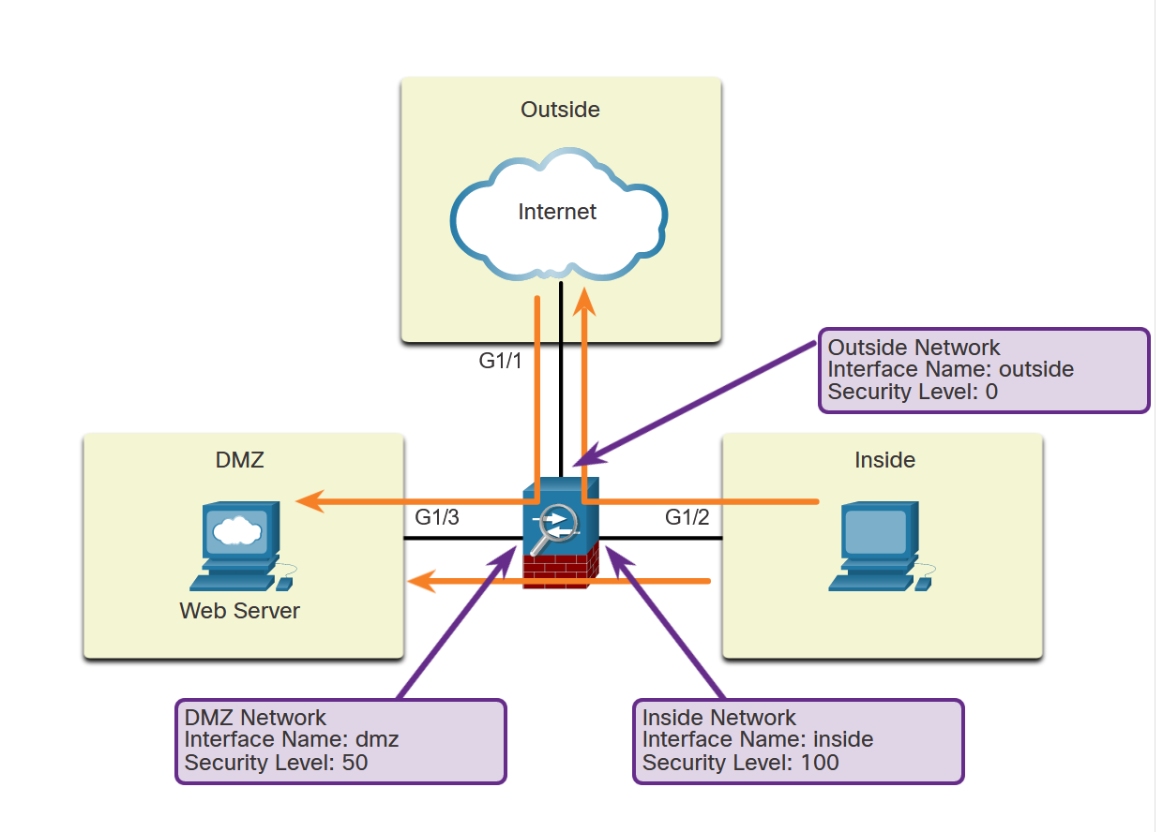
The ASA 5506-X with FirePOWER Services
ASA Security Levels
Security levels define the level of trustworthiness of an interface. Each operational interface must have a name and a security level from 0 (lowest) to 100 (highest) assigned.
As shown in the figure, level 100 should be assigned to the most secure network, such as the inside network. Level 0 can be assigned to the outside network, which is connected to the internet. DMZs and other networks can be assigned a security level between 0 and 100
Notes:
20: Introduction to the ASA 20.2: The ASA 5506-X with FirePOWER Services 20.2.2: ASA Security Levels

Slide 20
The ASA 5506-X with FirePOWER Services
ASA Security Levels (Cont.)
Security levels help to control many aspects of network traffic as shown in the table below.
Aspect | Effect
Network Access | By default, there is an implicit permit from a higher security interface to a lower security interface (outbound). Hosts on the higher security interface can access hosts on a lower security interface. Multiple interfaces can be assigned the same security level. If communication is enabled for interfaces with the same security level, there is an implicit permit for traffic between the interfaces.
Inspection Engines | Some application inspection engines are dependent on the security level. When interfaces have the same security level, the ASA inspects traffic in either direction.
Application Filtering | HTTPS and FTP filtering applies only for outbound connections that are from a higher level to a lower level. If communication is enabled for interfaces with the same security level, traffic can be filtered in either direction.
Notes:
20: Introduction to the ASA 20.2: The ASA 5506-X with FirePOWER Services 20.2.2: ASA Security Levels

Slide 21
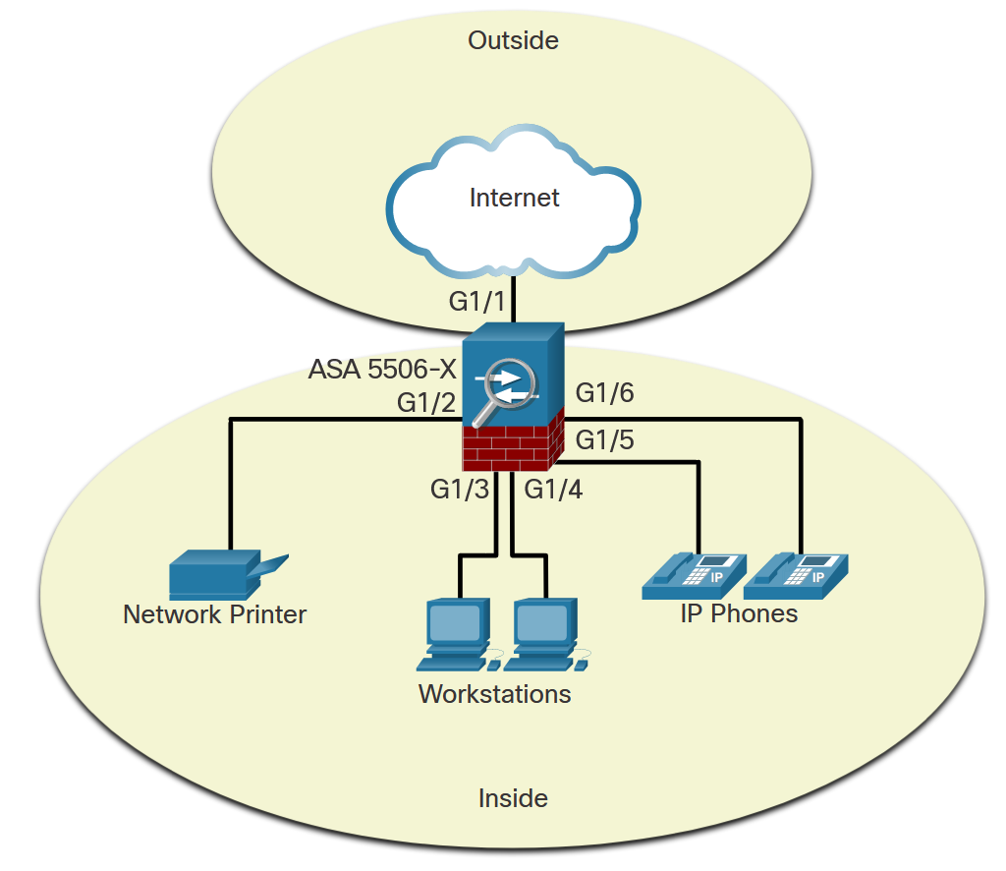
The ASA 5506-X with FirePOWER Services
ASA 5506-X Deployment Scenarios
Small Branch
The ASA 5506-X is commonly used as an edge security device. It connects a small business to an ISP device, such as a DSL or cable modem, for access to the internet. It can be deployed to interconnect and protect several workstations, network printers, and IP phones.
In a small branch, a common deployment would include an inside network (VLAN 1) with security level 100 and an outside network (VLAN 2) with security level 0, as shown in the figure.
Notes:
20: Introduction to the ASA 20.2: The ASA 5506-X with FirePOWER Services 20.2.3: ASA 5506-X Deployment Scenarios

Slide 22
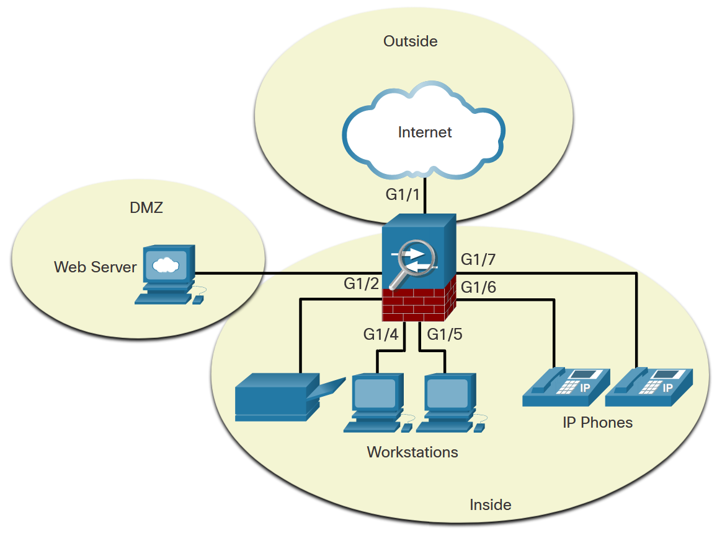
The ASA 5506-X with FirePOWER Services
ASA 5506-X Deployment Scenarios (Cont.)
Small Business
In the small business, shown here, the ASA 5506-X can be deployed with two different protected network segments. One segment is the inside network (VLAN 1), which connects workstations and IP phones. The other segment is the DMZ (VLAN 3), which connects a company web server. The outside interface (VLAN 2) is used to connect to the internet.
Notes:
20: Introduction to the ASA 20.2: The ASA 5506-X with FirePOWER Services 20.2.3: ASA 5506-X Deployment Scenarios

Slide 23
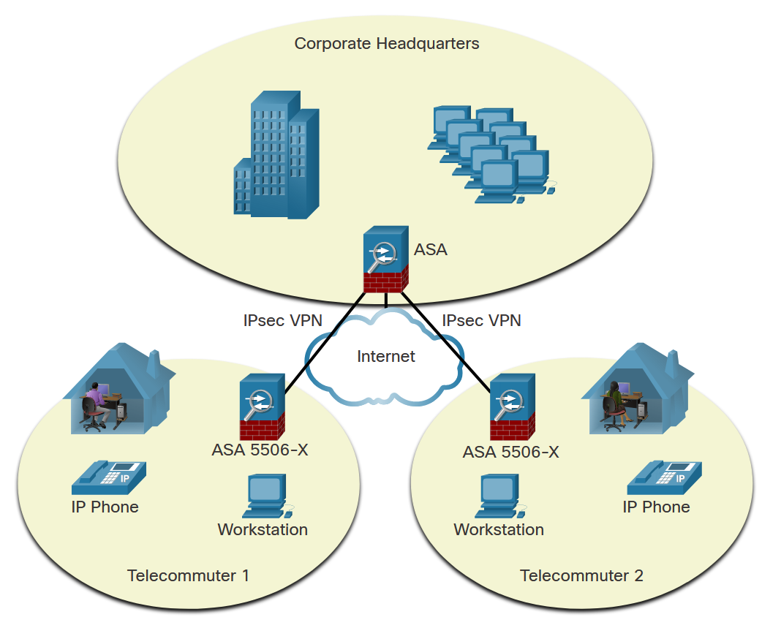
The ASA 5506-X with FirePOWER Services
ASA 5506-X Deployment Scenarios (Cont.)
Enterprise
In an enterprise deployment, as shown here, the ASA 5506-X can be used by telecommuters and home users to connect to a centralized location using a VPN.
Notes:
20: Introduction to the ASA 20.2: The ASA 5506-X with FirePOWER Services 20.2.3: ASA 5506-X Deployment Scenarios

Slide 24
Module 21: ASA Firewall Configuration
Instructor Materials
Networking Security v1.0
(NETSEC)
Notes:
Networking Security (NETSEC) Module 21: ASA Firewall Configuration

Slide 25
Module Objectives
Module Title: ASA Firewall Configuration
Module Objective: Implement an ASA firewall configuration.
Topic Title | Topic Objective
Basic ASA Firewall Configuration | Explain how to configure an ASA-5506-X with FirePOWER Services.
Configure Management Settings and Services | Configure management settings and services on an ASA 5506-X firewall.
Object Groups | Explain how to configure object groups on an ASA.
ASA ACLs | Use the correct commands to configure access lists with object groups on an ASA.
NAT Services on an ASA | Use the correct commands to configure an ASA to provide NAT services.
AAA | Use correct commands to configure access control using the local database and AAA server.
Service Policies on an ASA | Configure service policies on an ASA
Introduction to ASDM (Optional) | Note: This is an optional topic that is not assessed.
Notes:
25
21 – ASA Firewall Configuration
21.0.2 – What will I learn to do in this module?

Slide 26
21.1 Basic ASA Firewall Configuration
Notes:
21: ASA Firewall Configuration 21.1: Basic ASA Firewall Configuration

Slide 27
Basic ASA Firewall Configuration
Basic ASA Settings
The ASA command line interface (CLI) is a proprietary OS, which has a similar look and feel to the router IOS.
For example, the ASA CLI contains command prompts similar to that of a Cisco IOS router.
Abbreviation of commands and keywords
Use of the Tab key to complete a partial command
Use of the help key (?) after a command to view additional syntax
Notes:
21: ASA Firewall Configuration 21.1: Basic ASA Firewall Configuration 21.1.1: Basic ASA Settings

Slide 28
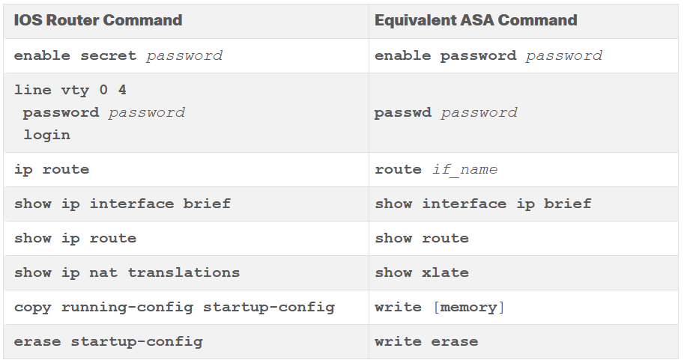
Basic ASA Firewall Configuration
Basic ASA Settings (Cont.)
The table contrasts common IOS router and ASA commands.
Notes:
21: ASA Firewall Configuration 21.1: Basic ASA Firewall Configuration 21.1.1: Basic ASA Settings

Slide 29
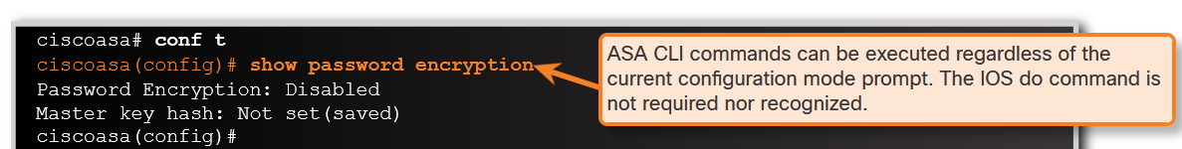
Basic ASA Firewall Configuration
Basic ASA Settings (Cont.)
ASA CLI commands can be executed regardless of the current configuration mode prompt.
Notes:
21: ASA Firewall Configuration 21.1: Basic ASA Firewall Configuration 21.1.1: Basic ASA Settings

Slide 30
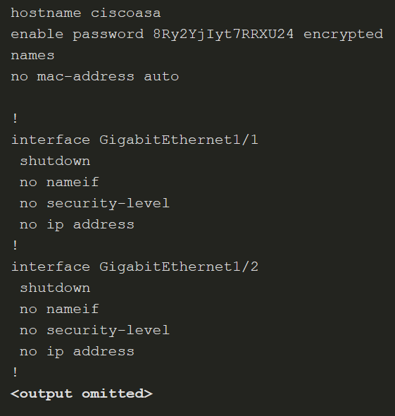
Basic ASA Firewall Configuration
ASA Default Configuration
The ASA 5506-X with FirePOWER Services ships with a default configuration that, in most instances, is sufficient for a basic SOHO deployment. Use the configure factory-default global configuration mode command to restore the factory default configuration.
The default hostname is ciscoasa. By default, the privileged EXEC and console line passwords are not configured.
These settings can be changed by:
Manually using the CLI
Interactively using the CLI Setup Initialization wizard
Using the ASDM Startup wizard
Notes:
21: ASA Firewall Configuration 21.1: Basic ASA Firewall Configuration 21.1.2: ASA Default Configuration

Slide 31
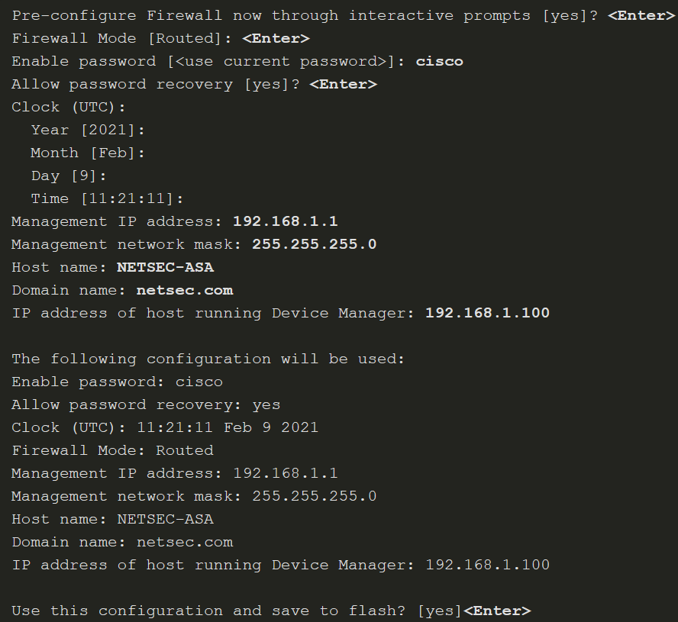
Basic ASA Firewall Configuration
ASA Interactive Setup Initialization Wizard
The wizard is displayed when there is no startup configuration, and prompts “Pre-configure Firewall now through interactive prompts [yes]?” To cancel and display the ASA default user EXEC mode prompt, enter no. Otherwise, enter yes or simply press Enter to accept the default [yes]. This initiates the wizard and the ASA interactively guides an administrator to configure the default settings.
Notes:
21: ASA Firewall Configuration 21.1: Basic ASA Firewall Configuration 21.1.3: ASA Interactive Setup Initialization Wizard

Slide 32
21.2 Configure Management Settings and Services
Notes:
21: ASA Firewall Configuration 21.2: Configure Management Settings and Services

Slide 33
Configure Management Settings and Services
Enter Global Configuration Mode
The default ASA user prompt of ciscoasa> is displayed when an ASA configuration is erased, the device is rebooted, and the user does not use the interactive setup wizard.
To enter privileged EXEC mode, use the enable user EXEC mode command. Initially, an ASA does not have a password configured; therefore, when prompted, leave the enable password prompt blank and press Enter.
The ASA date and time should be set either manually or by using Network Time Protocol (NTP). To set the date and time, use the clock set privileged EXEC command.
Enter global configuration mode using the configure terminal privileged EXEC command.
Notes:
21: ASA Firewall Configuration 21.2: Configure Management Settings and Services 21.2.1: Enter Global Configuration Mode

Slide 34
Configure Management Settings and Services
Configure Basic Settings
An ASA must be configured with basic management settings. The table displays the commands to accomplish this task.
ASA Command | Description
hostname name | Specifies a hostname up to 63 characters. A hostname must start and end with a letter or digit, and have as interior characters only letters, digits, or a hyphen.
domain-name name | Sets the default domain name.
enable password password | Sets the enable password for privileged EXEC mode. Sets the password as a case-sensitive string of 3 to 32 alphanumeric and special characters (not including a question mark or a space).
banner motd message | Provides legal notification and configures the system to display a message-of-the-day banner when connecting to the ASA.
key config-key password-encryption [ new-pass [ old-pass ]] | Sets the passphrase between 8 and 128 character long. Used to generate the encryption key.
password encryption aes | Enables password encryption and encrypts all user passwords.
Notes:
21: ASA Firewall Configuration 21.2: Configure Management Settings and Services 21.2.2: Configure Basic Settings

Slide 35
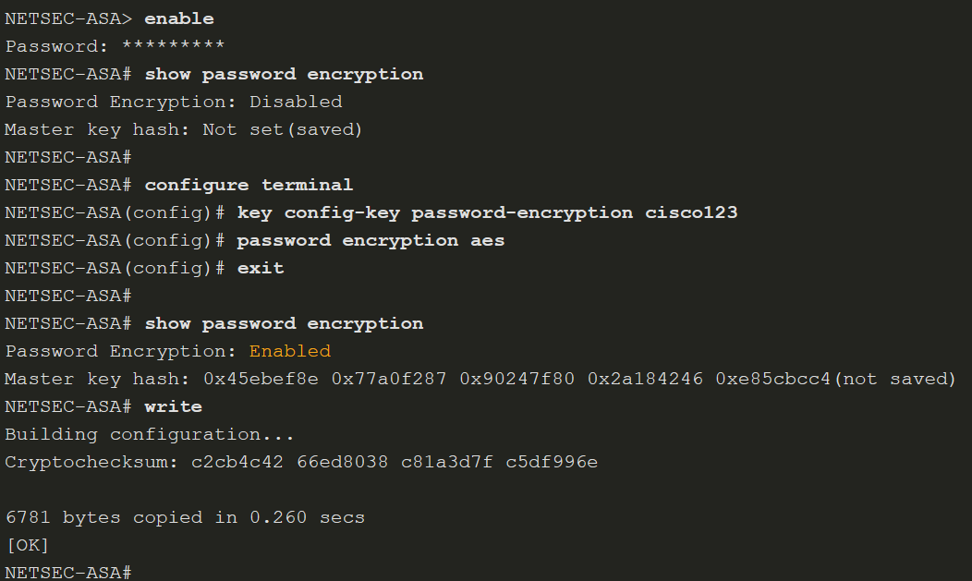
Configure Management Settings and Services
Configure Basic Settings (Cont.)
To configure a banner with several lines, the banner motd must be entered multiple times.
The privileged EXEC password is automatically encrypted using MD5. However, stronger encryption using AES should be enabled. To do so, a master passphrase must be configured, and AES encryption must be enabled.
To change the master passphrase, use the key config-key password-encryption password command. To determine if password encryption is enabled, use the show password encryption command.
Notes:
21: ASA Firewall Configuration 21.2: Configure Management Settings and Services 21.2.2: Configure Basic Settings
21.2.3: Syntax Checker - Configure Basic Settings on an ASA 5506-X

Slide 36
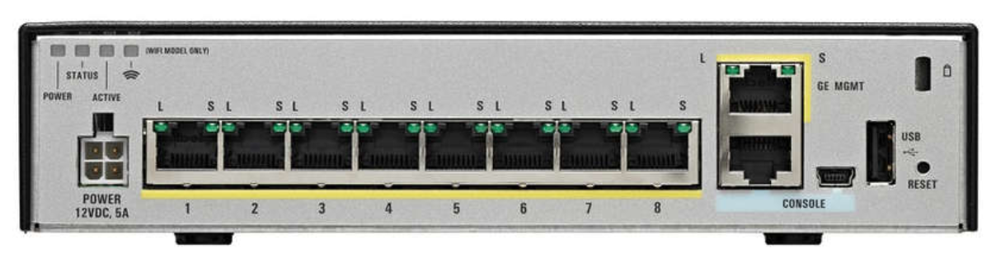
Configure Management Settings and Services
Configure Interfaces
The ASA-5506-X has eight Gigabit Ethernet interfaces that can be configured to carry traffic from different networks. The G1/1 interface is used by convention as the outside interface and is set to receive its IP address over DHCP by default.
The remaining interfaces, G1/2-G1/8, can be assigned to inside networks or DMZs. In addition, a Gigabit Ethernet port is dedicated to in-band management. It is designated as Management1/1. There are also RJ45 and USB console connections for out-of-band management.
Notes:
21: ASA Firewall Configuration 21.2: Configure Management Settings and Services 21.2.4: Configure Interfaces

Slide 37
Configure Management Settings and Services
Configure Interfaces (Cont.)
The IP address of an interface can be configured using one of the following options:
Manually - Commonly used to assign an IP address and mask to the interface.
DHCP - Used when an interface is connecting to an upstream device providing DHCP services.
PPPoE - Used when an interface is connecting to an upstream DSL device providing point-to-point connectivity over Ethernet services
The table lists the commands to configure an IP address on an interface.
To Configure | ASA Command | Description
Manually | ip address ip-address netmask | Assigns an IP address to the interface.
Using DHCP | ip address dhcp | The interface will request an IP address configuration from the upstream device.
 | ip address dhcp setroute | Used to have the interface request and install a default route to the upstream device.
Using PPP0E | ip address pppoe | Interface configuration mode command that requests an IP address from the upstream device.
 | ip address pppoe setroute | Same command but it also requests and installs a default route to the upstream device.
Notes:
21: ASA Firewall Configuration 21.2: Configure Management Settings and Services 21.2.4: Configure Interfaces

Slide 38
Configure Management Settings and Services
Configure Interfaces (Cont.)
Each interface must have a security level from 0 (lowest) to 100 (highest).
The commands below are used to configure basic interface parameters.
Verify the interface addressing and status with the show interface ip brief command as shown below. Note that the show command does not need to be entered in User EXEC mode.
ASA Command | Description
nameif if_name | Names the interface using a text string of up to 48 characters. The name is not case-sensitive. You can change the name by re-entering this command with a new value. Do not enter the no form, because that command causes all commands that refer to that name to be deleted.
security-level value | Sets the security level, where number is an integer between 0 (lowest) and 100 (highest).
no shutdown | Activate the interface.
Notes:
21: ASA Firewall Configuration 21.2: Configure Management Settings and Services 21.2.4: Configure Interfaces
21.2.5: Syntax Checker - Configure Inside, Outside, and DMZ Interfaces on an ASA 5506-X

Slide 39
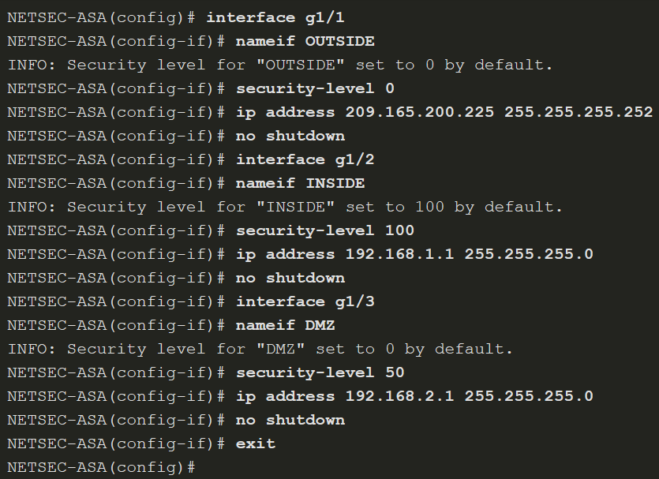
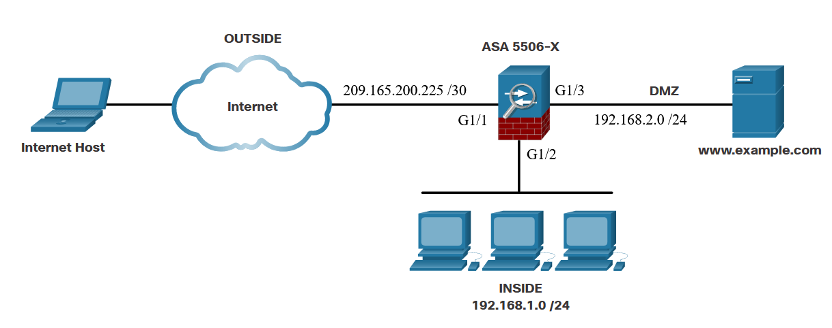
Configure Management Settings and Services
Configure Interfaces (Cont.)
Interface configuration example
Notes:
21: ASA Firewall Configuration 21.2: Configure Management Settings and Services 21.2.4: Configure Interfaces
21.2.5: Syntax Checker - Configure Inside, Outside, and DMZ Interfaces on an ASA 5506-X

Slide 40
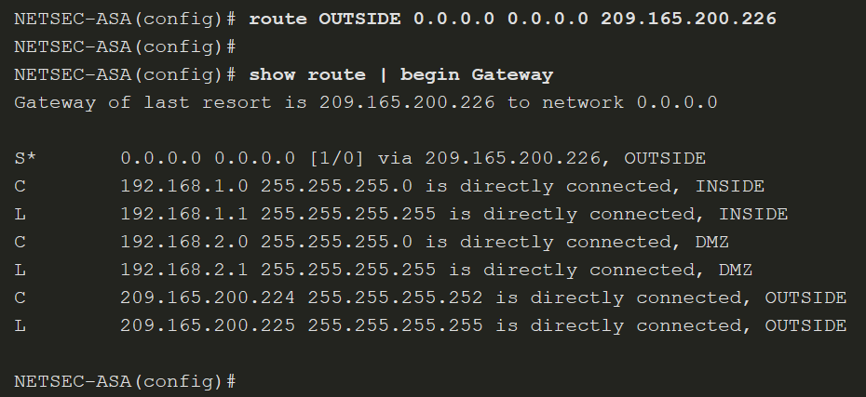
Configure Management Settings and Services
Configure a Default Static Route
Use the route interface-name 0.0.0.0 0.0.0.0 next-hop-ip-address command to configure a default route.
Notes:
21: ASA Firewall Configuration 21.2: Configure Management Settings and Services 21.2.6: Configure a Default Static Route
21.2.7: Syntax Checker - Configure a Default Static Route on an ASA 5506-X

Slide 41
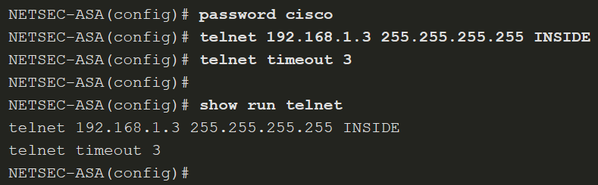
Configure Management Settings and Services
Configure Remote Access Services
Telnet or SSH is required to manage the ASA 5506-X remotely, using the CLI. To enable the Telnet service, use the commands listed in the table.
ASA Command | Description
{passwd | password} password | Sets the login password up to 80 characters in length for Telnet.
telnet { ipv4_address mask | ipv6_address/prefix } if_name | Identifies which inside host or network can Telnet to the ASA interface. Use the clear configure telnet command to remove the Telnet connection
telnet timeout minutes | By default, Telnet sessions left idle for five minutes are closed by the ASA. The command alters the default exec timeout of five minutes.
aaa authentication telnet console LOCAL | Configures Telnet to refer to the local database for authentication. The LOCAL keyword is case sensitive and is a predefined server tag.
clear configure telnet | Removes the Telnet connection from the configuration.
Notes:
21: ASA Firewall Configuration 21.2: Configure Management Settings and Services 21.2.8: Configure Remote Access Services

Slide 42
Configure Management Settings and Services
Configure Remote Access Services (Cont.)
To enable SSH, use the commands that are listed in the table. Example configuration is on the next slide
ASA Command | Description
username name password password | Creates a local database entry.
aaa authentication ssh console LOCAL | Configures SSH to refer to the local database for authentication. The LOCAL keyword is case sensitive and is a predefined server tag.
crypto key generate rsa modulus modulus_size | Generates the RSA key required for SSH encryption. The modulus_size (in bits) can be 512, 768, 1024, or 2048. A value of 2048 is recommended.
ssh { ip_address mask | ipv6_address/prefix } if_name | Identifies which inside host or network can SSH to the ASA interface. Multiple commands can be in the configuration. If the if_name is not specified, SSH is enabled on all interfaces except the outside interface. Use the clear configure ssh command to remove the SSH connection.
ssh version version_number | (Optional) By default, the ASA allows both SSH Version 1 (less secure) and Version 2 (more secure). Enter this command in order to restrict the connections to a specific version.
ssh timeout minutes | Alters the default exec timeout of five minutes.
clear configure ssh | Removes the SSH connection from the configuration.
Notes:
21: ASA Firewall Configuration 21.2: Configure Management Settings and Services 21.2.8: Configure Remote Access Services
21.2.9: Syntax Checker - Enable SSH Remote Access Using the Local Database on an ASA 5506-X

Slide 43
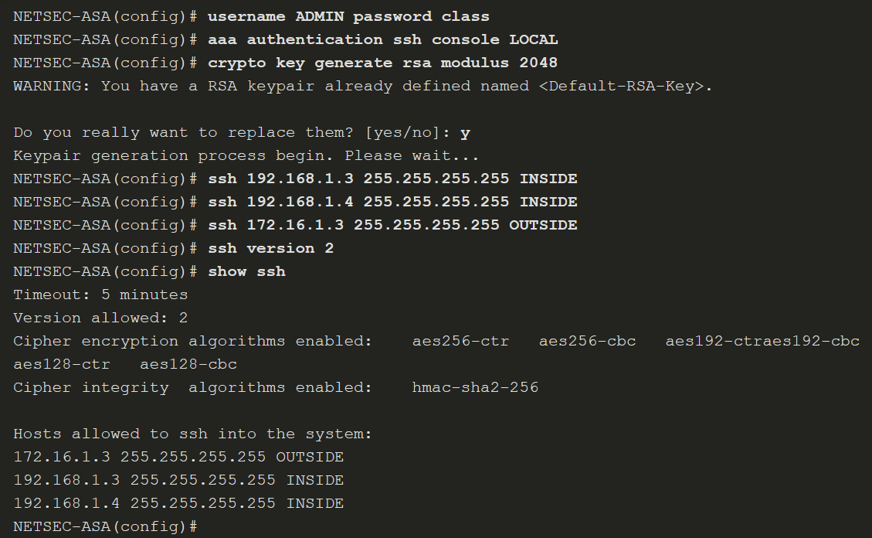
Configure Management Settings and Services
Configure Remote Access Services (Cont.)
Notes:
21: ASA Firewall Configuration 21.2: Configure Management Settings and Services 21.2.8: Configure Remote Access Services
21.2.9: Syntax Checker - Enable SSH Remote Access Using the Local Database on an ASA 5506-X

Slide 44
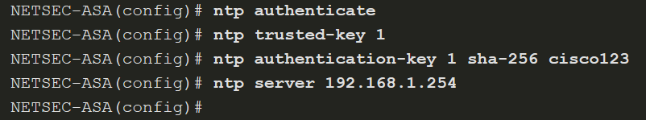
Configure Management Settings and Services
Configure Network Time Protocol Services
Network Time Protocol (NTP) services can be enabled on an ASA to obtain the date and time from an NTP server. To enable NTP, use the global configuration mode commands listed in the table. To verify the NTP configuration and status, use the show ntp status and show ntp associations commands
ASA Command | Description
ntp authenticate | Enables authentication with an NTP server.
ntp trusted-key key_id | Specifies an authentication key ID to be a trusted key, which is required for authentication with an NTP server.
ntp authentication-key key_id md5 key | Sets a key to authenticate with an NTP server.
ntp server ip_address [ key key_id ] | Identifies an NTP server.
Ntp authentication-key 1 md5 cisco123
Notes:
21: ASA Firewall Configuration 21.2: Configure Management Settings and Services 21.2.11: Configure Network Time Protocol Services
21.2.12: Syntax Checker - Enable NTP with Authentication on an ASA 5506-X

Slide 45
Configure Management Settings and Services
Configure DHCP Services
An ASA can be configured to be a DHCP server to provide IP addresses and DHCP-related information to hosts. To enable an ASA as a DHCP server and provide DHCP services to hosts, use the commands listed in the table. Example on the next slide
ASA Command | Description
dhcpd address IP_address1 [ -IP_address2 ] if_name | Creates a DHCP address pool in which IP_address1 is the start of the pool and IP_address2 is the end of the pool, separated by a hyphen. The address pool must be on the same subnet as the ASA interface.
dhcpd dns dns1 [ dns2 ] | (Optional) Specifies the IP address(es) of the DNS server(s).
dhcpd lease lease_length | (Optional) Changes the lease length granted to the client which is the amount of time in seconds that the client can use its allocated IP address before the lease expires. The lease_length defaults to 3600 seconds (1 hour) but can be a value from 0 to 1,048,575 seconds.
dhcpd domain domain_name | (Optional) Specifies the domain name assigned to the client.
dhcpd enable if_name | Enables the DHCP server service (daemon) on the interface (typically the inside interface) of the ASA.
Notes:
21: ASA Firewall Configuration 21.2: Configure Management Settings and Services 21.2.13: Configure DHCP Services
21.2.14: Syntax Checker - Configure DHCP Services

Slide 46
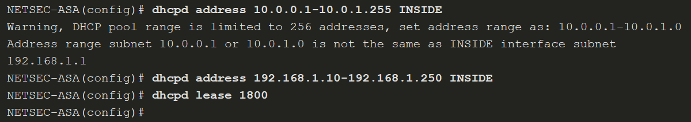
Configure Management Settings and Services
Configure DHCP Services (Cont.)
Dhcpd enable inside
Notes:
21: ASA Firewall Configuration 21.2: Configure Management Settings and Services 21.2.13: Configure DHCP Services
21.2.14: Syntax Checker - Configure DHCP Services

Slide 47
21.3 Object Groups
Notes:
21: ASA Firewall Configuration 21.3: Object Groups

Slide 48
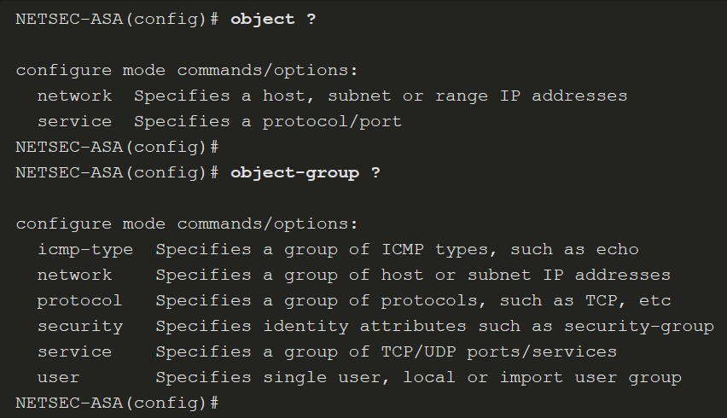
Object Groups
Introduction to Objects and Object Groups
Objects are reusable components for use in configurations. Objects can be defined and used in Cisco ASA configurations in the place of inline IP addresses, services, names, and so on.
The ASA supports objects and object groups, as shown in the output in the following output from the help facility:
Notes:
21: ASA Firewall Configuration 21.3: Object Groups 21.3.1: Introduction to Objects and Object Groups

Slide 49
Object Groups
Configure Network Objects
To create a network object, use the object network object-name global configuration mode command. The prompt changes to network object configuration mode.
Network objects can consist of the following:
host - a host address
fqdn - a fully-qualified domain name
range - a range of IP addresses
subnet - an entire IP network or subnet
Notes:
21: ASA Firewall Configuration 21.3: Object Groups 21.3.2: Configure Network Objects

Slide 50
Object Groups
Configure Network Objects (Cont.)
Commands available in network object configuration mode are shown in the table.
ASA Command | Description
attribute attribute-agent attribute-type attribute-value | Defined and used to filter traffic associated with one or more virtual machines.
description | Enter a description of the object up to 200 characters in length.
fqdn | A fully-qualified domain name such as the name of a host, such as www.example.com. Specify v4 to limit the address to IPv4, and v6 for IPv6. If you do not specify an address type, IPv4 is assumed.
host ip-address | The IPv4 or IPv6 address of a single host.
range start_add end_add | A range of addresses. You can specify IPv4 or IPv6 ranges. Do not include masks or prefixes.
subnet {ipv4_add ipv4_mask | ipv6_add/ipv6_prefix} | Assigns a network subnet to the named object.
Notes:
21: ASA Firewall Configuration 21.3: Object Groups 21.3.2: Configure Network Objects

Slide 51
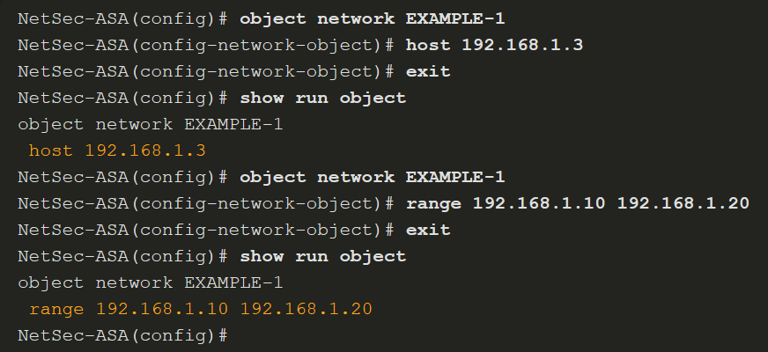
Object Groups
Configure Network Objects (Cont.)
The example displays a sample network object configuration. Notice that the configuration of range overwrites the previous configuration of host.
Notes:
21: ASA Firewall Configuration 21.3: Object Groups 21.3.2: Configure Network Objects

Slide 52
Object Groups
Configure Service Objects (PT nepodporuje)
The table provides an overview of common service options available. Optional keywords are used to identify source port or destination port, or both. Operators such as eq (equal), neq (not equal), lt (less than), gt (greater than), and range, support configuring a port for a given protocol. If no operator is specified, the default operator is eq.
Use the no form of the command to remove a service object. To erase all service objects, use the clear config object service command.
ASA Command | Description
service protocol | Specifies an IP protocol name or number.
service tcp [source operator port] [destination operator port] | Specifies that the service object is for the TCP protocol.
service udp [source operator port] [destination operator port] | Specifies that the service object is for the UDP protocol.
service icmp [icmp-type [icmp_code]] | Specifies that the service object is for the ICMP protocol.
service icmp6 [icmp-type [icmp_code]] | Specifies that the service object is for the ICMPv6 protocol.
Notes:
21: ASA Firewall Configuration 21.3: Object Groups 21.3.3: Configure Service Objects

Slide 53
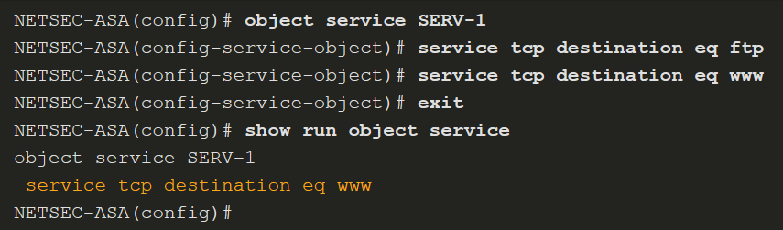
Object Groups
Configure Service Objects (Cont.)
A service object name can only be associated with one protocol and port (or ports), as shown in the show run object service output in this example.
Len posledný záznam – lebo object 1 položka, object-group viac položiek ...
Notes:
21: ASA Firewall Configuration 21.3: Object Groups 21.3.3: Configure Service Objects

Slide 54
Object Groups
Object Groups
Objects can be grouped together to create an object group. By grouping like objects together, an object group can be used in an access control entry (ACE) instead of having to enter an ACE for each object separately.
The following guidelines and limitations apply to object groups:
Objects and object groups share the same name space.
Object groups must have unique names.
An object group cannot be removed or emptied if it is used in a command.
The ASA does not support IPv6 nested object groups.
Notes:
21: ASA Firewall Configuration 21.3: Object Groups 21.3.4: Object Groups

Slide 55
Object Groups
Object Groups (Cont.)
There are five types of object groups.
Network - A network-based object group specifies a list of IP host, subnet, or network addresses.
User - Locally created, as well as imported Active Directory user groups can be defined for use in features that support the identity firewall.
Service - A service-based object group is used to group TCP, UDP, or TCP and UDP ports into an object. The ASA enables the creation of a service object group that can contain a mix of TCP services, UDP services, ICMP-type services, and any protocol, such as ESP, GRE, and TCP.
ICMP-Type - The ICMP protocol uses unique types to send control messages (RFC 792). The ICMP-type object group can group the necessary types required to meet an organization’s security needs, such as to create an object group called ECHO to group echo and echo-reply.
Security - A security group object group can be used in features that support Cisco TrustSec by including the group in an extended ACL, which in turn can be used in an access rule.
Notes:
21: ASA Firewall Configuration 21.3: Object Groups 21.3.4: Object Groups

Slide 56
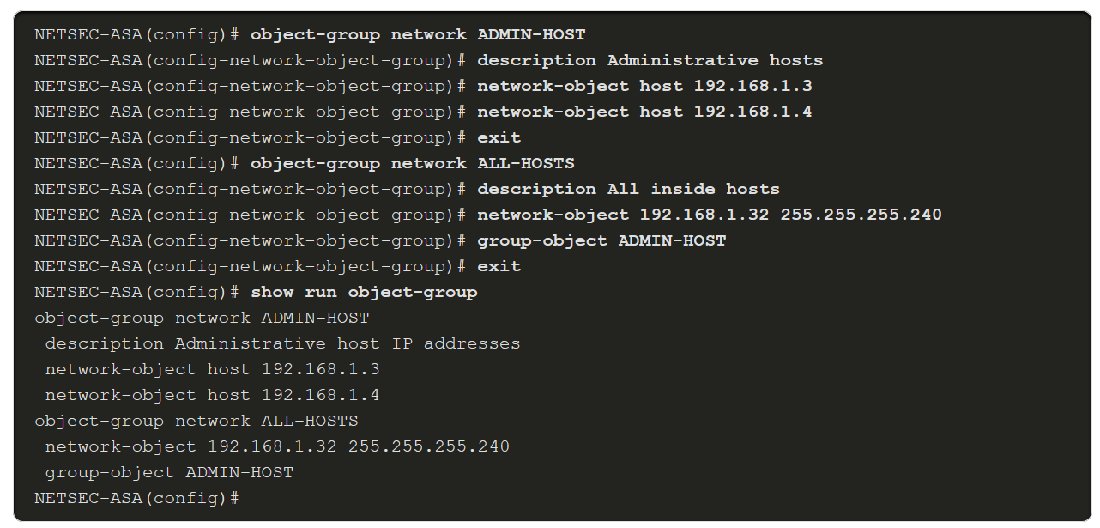
Object Groups
Configure Common Object Groups
To configure a network object group, use the object-group network grp-name global configuration mode command. After entering the command, add network objects to the network group using the network-object and group-object commands.
To configure an ICMP object group, use the object-group icmp-type grp-name global configuration mode command. After entering the command, add ICMP objects to the ICMP object group using the icmp-object and group-object commands.
The example displays a sample network object group configuration.
Notes:
21: ASA Firewall Configuration 21.3: Object Groups 21.3.5: Configure Common Object Groups
21.3.6: Check Your Understanding - Identify Types of Object Groups

Slide 57
21.4 ASA ACLs
Notes:
21: ASA Firewall Configuration 21.4: ASA ACLs

Slide 58
ASA ACLs
ASA ACLs
These are the similarities between ASA ACLs and IOS ACLs:
ACLs are made up of one or more ACEs. ACEs are applied to a protocol, a source and destination IP address, a network, or the source and destination ports.
ACLs are processed sequentially from top down.
A criteria match will cause the ACL to be exited.
There is an implicit deny any at the bottom.
Remarks can be added per ACE or ACL.
Only one access list can be applied per interface, per protocol, per direction.
ACLs can be enabled/disabled based on time ranges.
These the differences between ASA ACLs and IOS ACLs:
The ASA uses a network mask (e.g., 255.255.255.0) and not a wildcard mask (e.g. 0.0.0.255).
ACLs are always named instead of numbered.
By default, interface security levels apply access control without an ACL configured.
Notes:
21: ASA Firewall Configuration 21.4: ASA ACLs 21.4.1: ASA ACLs

Slide 59
ASA ACLs
Types of ASA ACL Filtering
ACLs on a security appliance can be used not only to filter packets that are passing through the appliance but also to filter packets destined for the appliance.
Through-traffic filtering - Traffic passing through the ASA from one interface to another interface. The configuration is completed in two steps: configure the ACL, then apply the ACL to an interface.
To-the-box-traffic filtering - management access rule that applies to traffic that terminates at the ASA.
Notes:
21: ASA Firewall Configuration 21.4: ASA ACLs 21.4.2: Types of ASA ACL Filtering

Slide 60
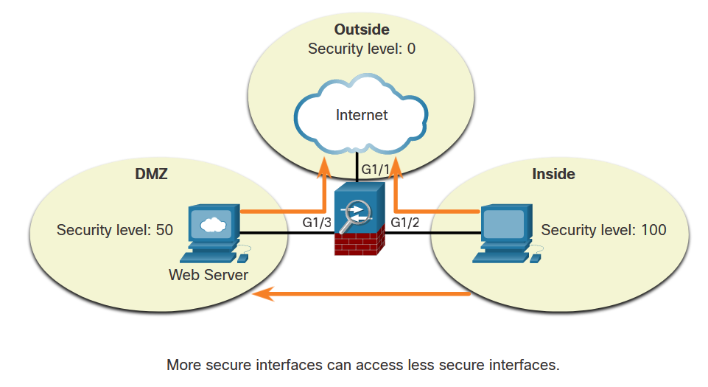
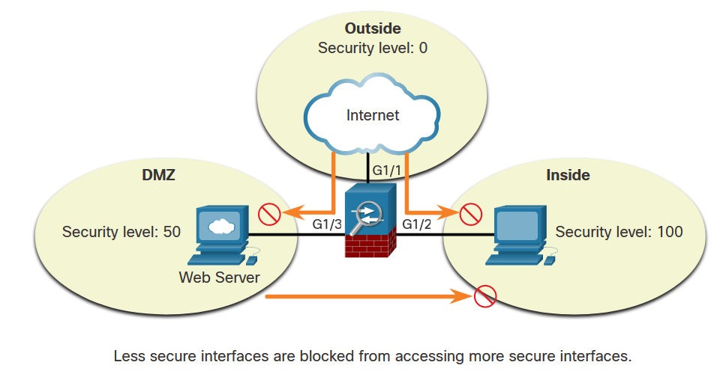
ASA ACLs
Types of ASA ACL Filtering (Cont.)
ASA devices differ from their router counterparts because of interface security levels. By default, security levels apply access control without an ACL configured.
However, a host from an outside interface with security level 0 cannot access the inside higher-level interface, as shown below.
Notes:
21: ASA Firewall Configuration 21.4: ASA ACLs 21.4.2: Types of ASA ACL Filtering

Slide 61
ASA ACLs
Types of ASA ACL Filtering (Cont.)
A from an outside interface with security level 0 cannot access the inside higher-level interface, as shown in the figure.
Use the same-security-traffic permit inter-interface to enable traffic between interfaces with the same security level. Use the same-security-traffic permit intra-interface command to allow traffic to enter and exit the same interface
Notes:
21: ASA Firewall Configuration 21.4: ASA ACLs 21.4.2: Types of ASA ACL Filtering

Slide 62
ASA ACLs
Types of ASA ACLs
The ASA supports five types of access lists:
Extended access list - The most common type of ACL.
Standard access list - Unlike IOS where a standard ACL identifies the source host/network, ASA standard ACLs are used to identify the destination IP addresses. Standard access lists cannot be applied to interfaces to control traffic.
EtherType access list - An EtherType ACL can be configured only if the security appliance is running in transparent mode.
Webtype access list - Used for filtering for clientless SSL VPN traffic. These ACLs can deny access based on URLs or destination addresses.
IPv6 access list - Used to determine which IPv6 traffic to block and which traffic to forward at router interfaces.
Use the help access-list privileged EXEC command to display the syntax for all of the ACLs supported on an ASA platform.
Notes:
21: ASA Firewall Configuration 21.4: ASA ACLs 21.4.3: Types of ASA ACLs

Slide 63
ASA ACLs
Types of ASA ACLs (Cont.)
The table provides examples of the uses of extended ACLs.
ACL Use | Description
Control network access for IP traffic | The ASA does not allow any traffic from a lower security interface to a higher security interface unless it is explicitly permitted by an extended access list.
Identify traffic for AAA rules | AAA rules use access lists to identify traffic.
Identify addresses for NAT | Policy NAT lets you identify local traffic for address translation by specifying the source and destination addresses in an extended access list.
Establish VPN access | Extended access list can be used in VPN commands.
Identify traffic for Modular Policy Framework (MPF) | Access lists can be used to identify traffic in a class map, which is used for features that support MPF. Features that support MPF include TCP, general connection settings, and inspection.
Notes:
21: ASA Firewall Configuration 21.4: ASA ACLs 21.4.3: Types of ASA ACLs

Slide 64
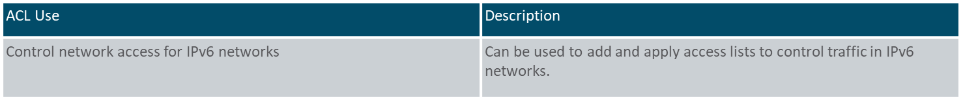
ASA ACLs
Types of ASA ACLs (Cont.)
The table provides examples of uses of standard ACLs.
ACL Use | Description
Identify OSPF destination network in route maps | Standard access lists include only the destination address. It can be used to control the redistribution of OSPF routes.
VPN filters | Filter traffic for LAN-to-LAN (L2L), Cisco VPN Client, and the Cisco AnyConnect Secure Mobility Client traffic.
The table provides examples of uses of IPv6 ACLs.
Notes:
21: ASA Firewall Configuration 21.4: ASA ACLs 21.4.3: Types of ASA ACLs

Slide 65
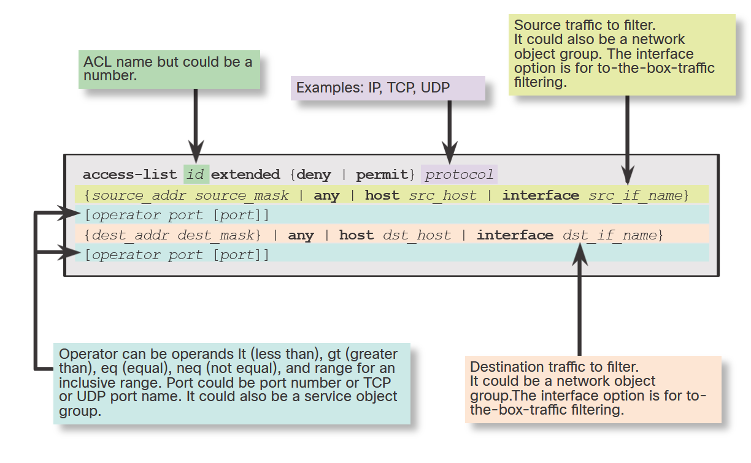
ASA ACLs
Syntax for Configuring an ASA ACL
IOS and ASA ACLs have similar elements, but some options vary with the ASA.
There are many options that can be used with ACLs. However, for most needs, a more useful and condensed version of the syntax is shown in the figure.
ACL používa sieťovú masku – nie wildcard !!!
Notes:
21: ASA Firewall Configuration 21.4: ASA ACLs 21.4.4: Configure ACLs

Slide 66
ASA ACLs
Syntax for Configuring an ASA ACL (Cont.)
The table describes elements of an ASA ACL.
Element | Description
ACL id | The name of the ACL.
Action | Can be permit or deny.
Protocol number - Source | Can be IP for all traffic, or the name / IP protocol number (0-250) including icmp ( 1), tcp ( 6), udp ( 17), or a protocol object-group.
Source | Identifies the source and can be any, a host, a network, or a network object group. For to-the-box-traffic filtering, the interface keyword is used to specify the source interface of the ASA.
Source port operator | (Optional) Operand is used in conjunction with the source port. Valid operands include lt (less than), gt (greater than), eq (equal), neq (not equal), and range for an inclusive range.
Source port | (Optional) Can be the actual TCP or UDP port number, select port names, or service object group.
Destination | Identifies the destination and like the source, it can be any, a host, a network, or a network object group. For to-the-box-traffic filtering, the interface keyword is used to specify the destination interface of the ASA.
Destination port operator | (Optional) Operand is used in conjunction with the destination port. Valid operands are the same as the source port operands.
Destination port | (Optional) Can be the actual TCP or UDP port number, select port names, or service object group.
Log | Can set elements for syslog including severity level and log interval.
Time range | (Optional) Specify a time range for the ACE.
Notes:
21: ASA Firewall Configuration 21.4: ASA ACLs 21.4.4: Configure ACLs

Slide 67
ASA ACLs
Syntax for Applying an ASA ACL
The example displays the command syntax and parameter description for applying the ACL to an interface using the access-group command syntax. To verify ACLs, use the show access-list and show running-config access-list commands. To erase a configured ACL, use the clear configure access-list id command.
Syntax | Description
access-group | Keyword used to apply an ACL to an interface.
id | The name of the actual ACL to be applied to an interface.
in | The ACL will filter inbound packets.
out | The ACL will filter outbound packets.
interface | Keyword to specify the interface to which to apply the ACL.
if_name | The name of the interface to which to apply an ACL.
per-user-override | Option that allows downloadable ACLs to override the entries on the interface ACL.
control-plane | Keyword to specify whether the applied ACL analyzes traffic destined to ASA for management purposes.
Notes:
21: ASA Firewall Configuration 21.4: ASA ACLs 21.4.5: Apply ACLs

Slide 68
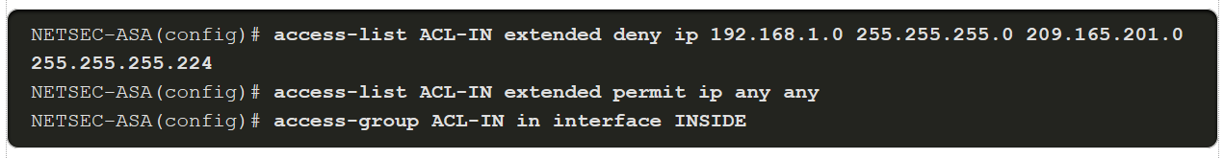
ASA ACLs
ASA ACL Examples
Example 1
ACL allows all hosts on the inside network to go through the ASA.
By default, all other traffic is denied unless explicitly permitted.
Example 2
ACL prevents hosts on 192.168.1.0/24 from accessing the 209.165.201.0/27 network.
Internal hosts are permitted access to all other addresses.
All other traffic is implicitly denied.
ACL používa sieťovú masku – nie wildcard !!!
Notes:
21: ASA Firewall Configuration 21.4: ASA ACLs 21.4.6: ACLs and Object Groups

Slide 69
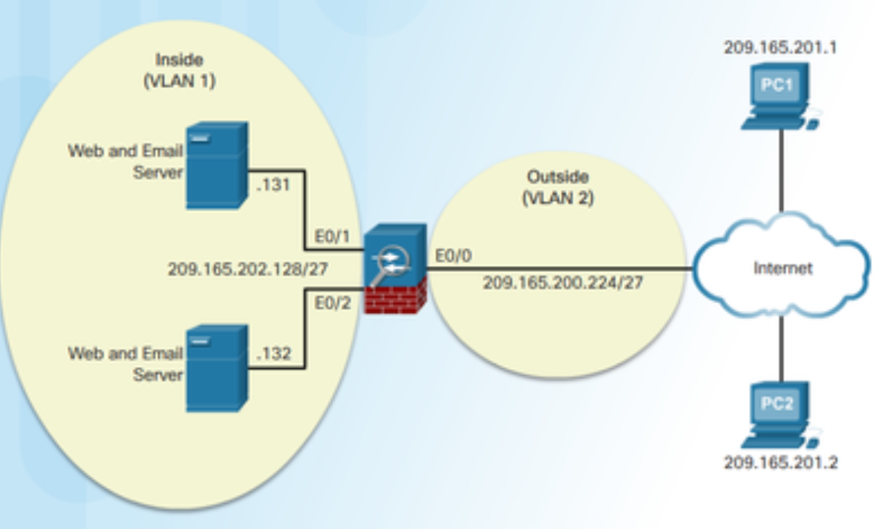
ASA ACLs
ACLs and Object Groups
Consider the sample topology in the figure in which access from two trusted, remote hosts, PC1 and PC2, should be allowed to the two internal for web and email servers. All other traffic attempting to pass through the ASA should be dropped and logged.
The ACL would require two ACEs for each PC to accomplish the task. The implicit deny any drops and logs any packets that do not match email or web services. As shown in the example, ACLs should always be thoroughly documented using the remark command.
To verify the ACL syntax, use the show running-config access-list and show access-list commands, as shown in the example.
Notes:
21: ASA Firewall Configuration 21.4: ASA ACLs 21.4.7: ACLs and Object Groups

Slide 70
ASA ACLs
ACL Using Object Groups Examples
Object grouping is a way to group similar items together to reduce the number of ACEs.
Object grouping can cluster network objects into one group and outside hosts into another, as shown in the following syntax. The security appliance can also combine both TCP services into a service object group.
Notes:
21: ASA Firewall Configuration 21.4: ASA ACLs 21.4.7: ACL Using Object Groups Examples
21.4.8: Syntax Checker - Configure an ASA ACL Using Object Groups with the CLI

Slide 71
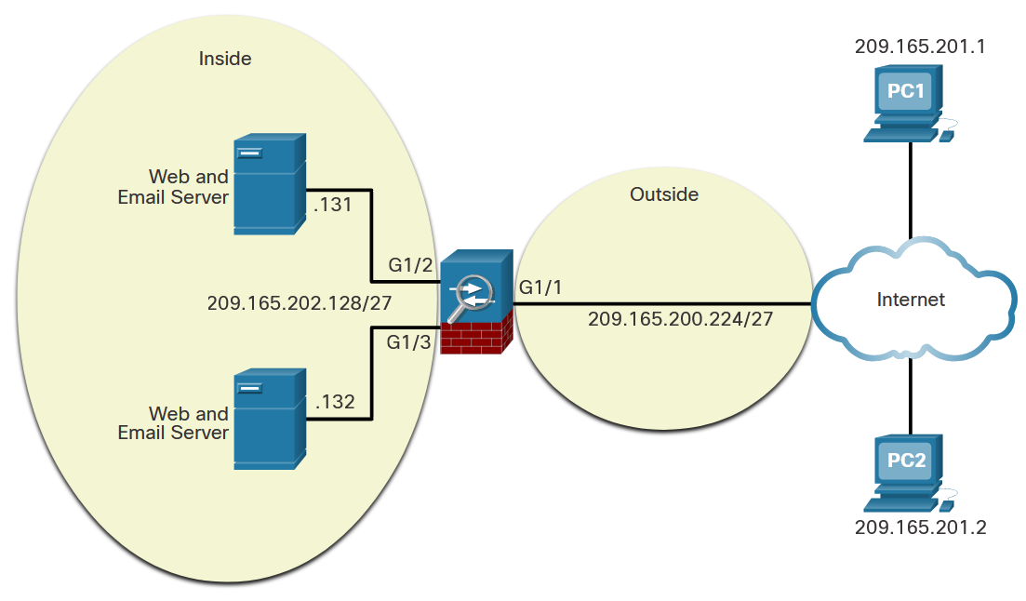
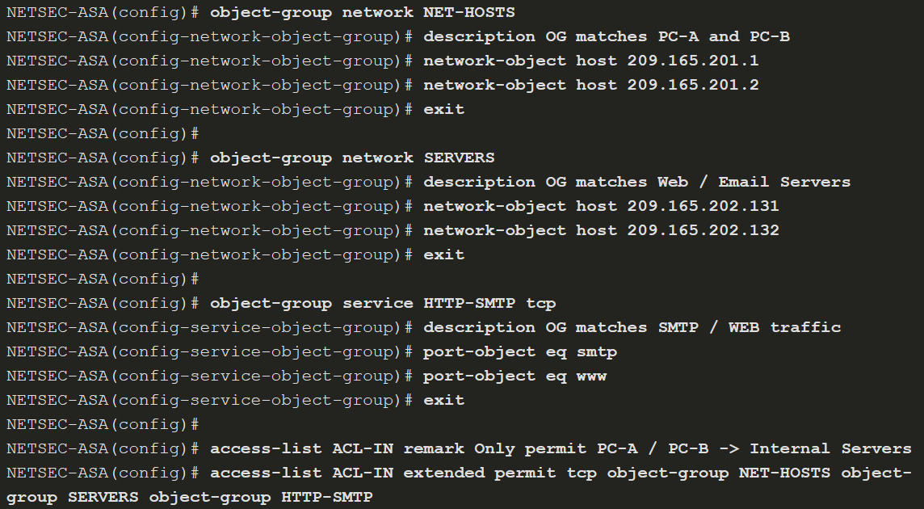
ASA ACLs
ACL Using Object Groups Examples (Cont.)
This example shows how to configure the following three object groups:
NET-HOSTS - Identifies two external hosts.
SERVERS - Identifies servers providing email and web services.
HTTP-SMTP - Identifies SMTP and HTTP protocols.
Notes:
21: ASA Firewall Configuration 21.4: ASA ACLs 21.4.7: ACL Using Object Groups Examples
21.4.8: Syntax Checker - Configure an ASA ACL Using Object Groups with the CLI

Slide 72
21.5 NAT Services on an ASA
Notes:
21: ASA Firewall Configuration 21.5: NAT Services on an ASA

Slide 73
NAT Services on an ASA
ASA NAT Overview
NAT can be deployed using one of the methods:
Inside NAT
Outside NAT
Bidirectional NAT
Specifically, the Cisco ASA supports the following common types of NAT:
Dynamic PAT - This is a many-to-one translation. This is also known as NAT with overload. Usually, an inside pool of private addresses overloading an outside interface or outside address.
Static NAT - This is a one-to-one translation. Usually an outside address mapping to an internal server.
Policy NAT - Policy-based NAT is based on a set of rules.
Identity NAT - A real address is statically translated to itself, essentially bypassing NAT.
Notes:
21: ASA Firewall Configuration 21.5: NAT Services on an ASA 21.5.1: ASA NAT Overview

Slide 74
NAT Services on an ASA
Configure Dynamic NAT (PT nepodporuje)
To configure network object dynamic NAT, two network objects are required:
Identify the pool of public IP addresses with the range or subnet network object commands.
Identify the internal addresses to be translated with the range or subnet network object commands.
The two network objects are then bound together using nat [(real_if_name,mapped_if_name)] dynamic mapped_obj [interface [ipv6]] [dns] network object command. The real_if_name is the prenat interface. The mapped_if_name is the postnat interface. Notice that there is no space after the comma in the command syntax.
Notes:
21: ASA Firewall Configuration 21.5: NAT Services on an ASA 21.5.2: Configure Dynamic NAT
21.5.3: Syntax Checker - Configure ASA Dynamic NAT with the CLI

Slide 75
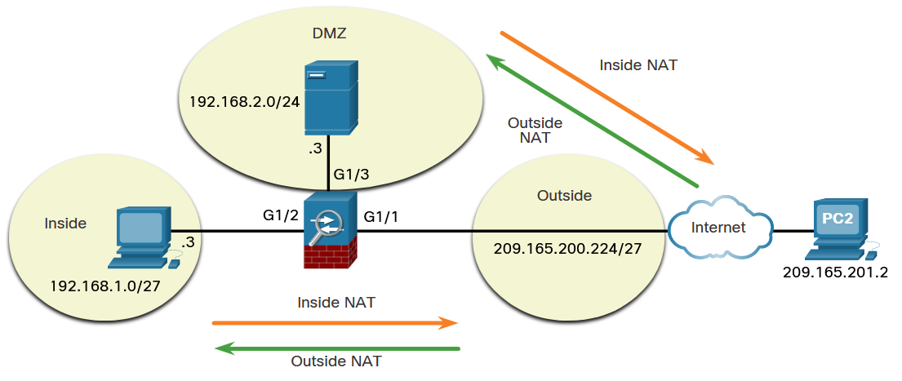
NAT Services on an ASA
Configure Dynamic NAT (Cont.)
In this dynamic NAT example, the inside hosts on the 192.168.1.0/27 network will be dynamically assigned a range of public IP address from 209.165.200.225 to 209.165.200.254.
Notes:
21: ASA Firewall Configuration 21.5: NAT Services on an ASA 21.5.2: Configure Dynamic NAT
21.5.3: Syntax Checker - Configure ASA Dynamic NAT with the CLI

Slide 76
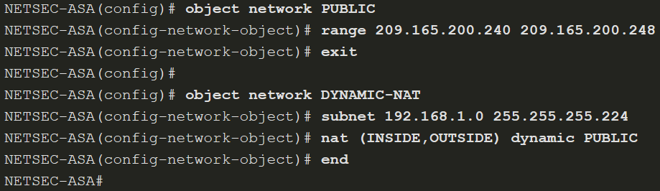
NAT Services on an ASA
Configure Dynamic NAT (Cont.)
The example displays a sample dynamic NAT configuration to accomplish this task. The PUBLIC network object identifies the public IP addresses to be translated to while the DYNAMIC-NAT object identifies the internal addresses to be translated and is bound to the PUBLIC network object with the nat command.
range 209.165.200.225 209.165.200.254
Toto nestačí, nie je povolený žiadny návratový traffic ...
Notes:
21: ASA Firewall Configuration 21.5: NAT Services on an ASA 21.5.2: Configure Dynamic NAT
21.5.3: Syntax Checker - Configure ASA Dynamic NAT with the CLI

Slide 77
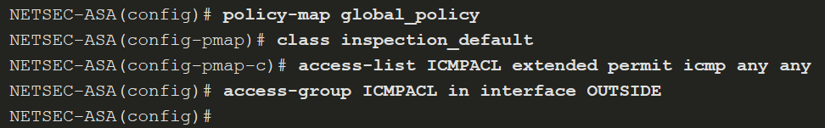
NAT Services on an ASA
Configure Dynamic NAT (Cont.)
The following example shows how to allow inside hosts to ping outside hosts.
Alebo aj takto pre ftp, http, icmp a tftp:
policy-map global_policy
class inspection_default
inspect ftp
inspect http
inspect icmp
inspect tftp
To verify the network address translation, use show xlate, show nat, and show nat detail commands.
Notes:
21: ASA Firewall Configuration 21.5: NAT Services on an ASA 21.5.2: Configure Dynamic NAT
21.5.3: Syntax Checker - Configure ASA Dynamic NAT with the CLI

Slide 78
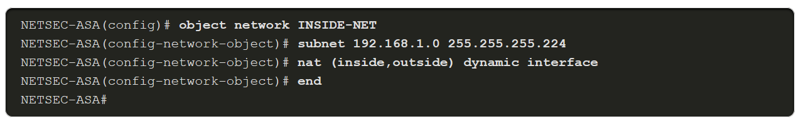
NAT Services on an ASA
Configure Dynamic PAT
To enable inside hosts to overload the outside address, use nat [(real_if_name,mapped_if_name)] dynamic interface command, as shown in the example.
Notes:
21: ASA Firewall Configuration 21.5: NAT Services on an ASA 21.5.4: Configure Dynamic PAT

Slide 79
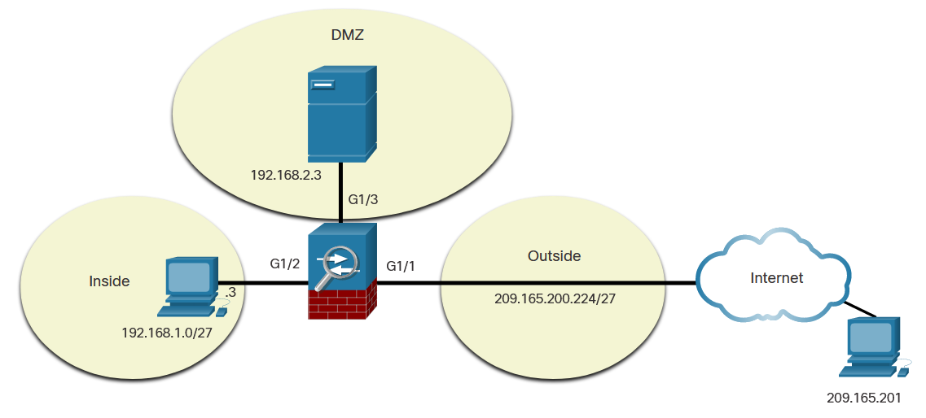
NAT Services on an ASA
Configure Static NAT
Static NAT is configured when an inside address is mapped to an outside address. For instance, static NAT can be used when a server must be accessible from the outside.
To configure static NAT, use the nat [(real_if_name,mapped_if_name)] static mapped-inline-host-ip network object command. The example configuration is on the next slide.
Notes:
21: ASA Firewall Configuration 21.5: NAT Services on an ASA 21.5.5: Configure Static NAT
21.5.6: Syntax Checker - Configure the ASA DMZ and Static NAT with the CLI

Slide 80
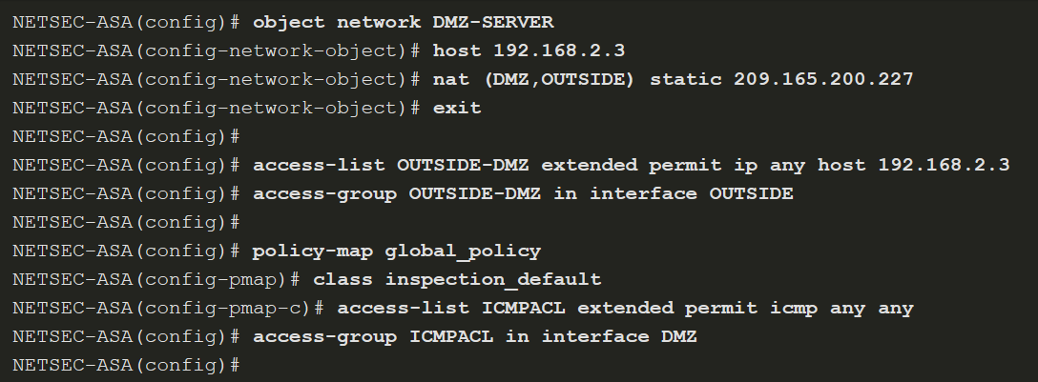
NAT Services on an ASA
Configure Static NAT (Cont.)
Notes:
21: ASA Firewall Configuration 21.5: NAT Services on an ASA 21.5.5: Configure Static NAT
21.5.6: Syntax Checker - Configure the ASA DMZ and Static NAT with the CLI

Slide 81
21.6 AAA
Notes:
21: ASA Firewall Configuration 21.6: AAA

Slide 82
AAA
AAA Review
Authentication, authorization, and accounting (AAA) provides an extra level of protection and user control. Using AAA only, authenticated and authorized users can be permitted to connect through the ASA.
Authorization controls access, per user, after users are authenticated. Authorization controls the services and commands that are available to each authenticated user.
Accounting tracks traffic that passes through the ASA, enabling administrators to have a record of user activity.
Notes:
21: ASA Firewall Configuration 21.6: AAA 21.6.1: AAA Review

Slide 83
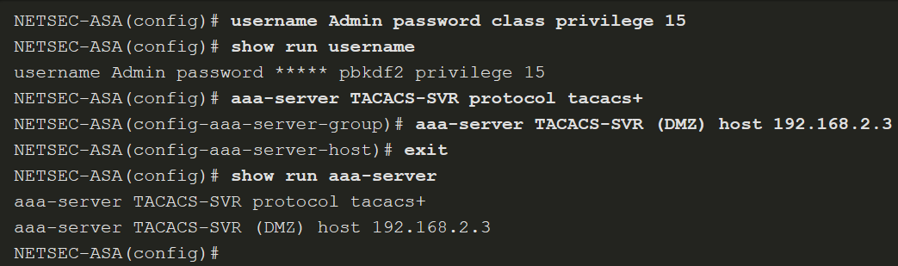
AAA
Local Database and Servers (PT nepodporuje aaa server)
Use the username name password password [privilege priv-level] command to create local user accounts. To erase a user from the local database, use the clear config username [name] command. To view all user accounts, use the show running-config username command.
To configure a TACACS+ or RADIUS server, use the commands listed in the table.
ASA Command | Description
aaa-server server-tag protocol protocol | Creates a TACACS+ or RADIUS AAA server group.
aaa-server server-tag [(-interface name )] host {server-ip | name } [ key ] | Configures a AAA server as part of a AAA server group. Also configures AAA server parameters that are host-specific.
The example shows configuration of a AAA TACACS+ server on an ASA 5506-X.
Notes:
21: ASA Firewall Configuration 21.6: AAA 21.6.2: Local Database and Servers

Slide 84
AAA
AAA Configuration
To authenticate users who access the ASA CLI over a console (serial), SSH, HTTPS (ASDM), or Telnet connection, or to authenticate users who access privileged EXEC mode using the enable command, use the aaa authentication enable console command in global configuration mode.
Notes:
21: ASA Firewall Configuration 21.6: AAA 21.6.3: AAA Configuration
21.6.4: Syntax Checker - Configure AAA on the ASA with the CLI

Slide 85
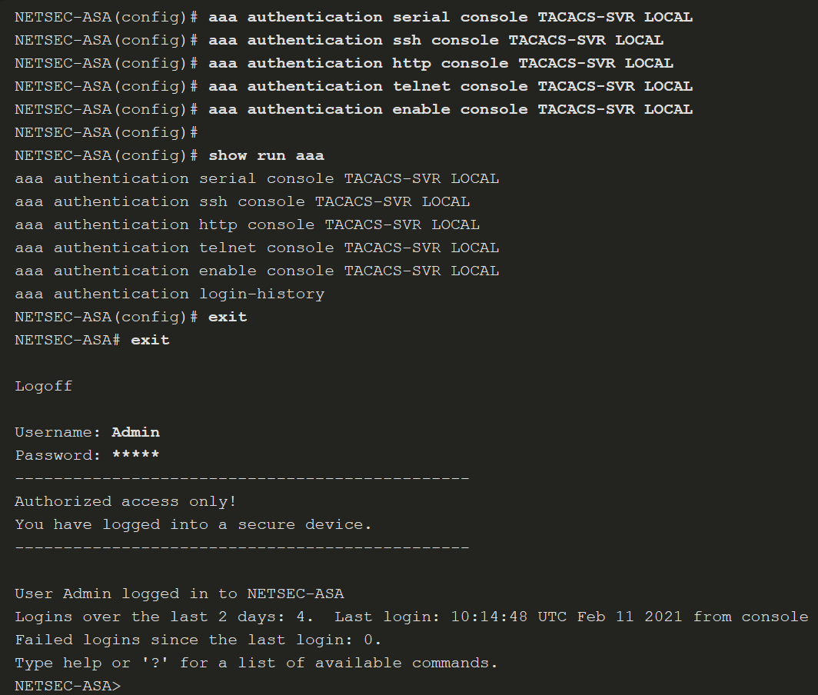
AAA
AAA Configuration (Cont.)
The example provides a sample AAA configuration that is then verified and tested.
Notes:
21: ASA Firewall Configuration 21.6: AAA 21.6.3: AAA Configuration
21.6.4: Syntax Checker - Configure AAA on the ASA with the CLI

Slide 86
21.7 Service Policies on an ASA
Notes:
21: ASA Firewall Configuration 21.7: Service Policies on an ASA

Slide 87
Service Policies on an ASA
Overview of MPF
A Modular Policy Framework (MPF) configuration defines a set of rules for applying firewall features, such as traffic inspection and QoS, to the traffic that traverses the ASA. MPF allows granular classification of traffic flows, which enables the application of different advanced policies to different flows.
Cisco MPF uses three configuration objects to define modular, object-oriented, hierarchical policies:
Class Maps - What are we looking for?
Policy Maps - What shall we do with it?
Service Policy - Where do we do it?
Notes:
21: ASA Firewall Configuration 21.7: Service Policies on an ASA 21.7.1: Overview of MPF

Slide 88
Service Policies on an ASA
Overview of MPF (Cont.)
There are four steps to configure MPF on an ASA:
Step 1. (Optional) Configure extended ACLs to identify granular traffic that can be specifically referenced in the class map.
Step 2. Configure the class map to identify traffic.
Step 3. Configure a policy map to apply actions to those class maps.
Step 4. Configure a service policy to attach the policy map to an interface.
Notes:
21: ASA Firewall Configuration 21.7: Service Policies on an ASA 21.7.1: Overview of MPF

Slide 89
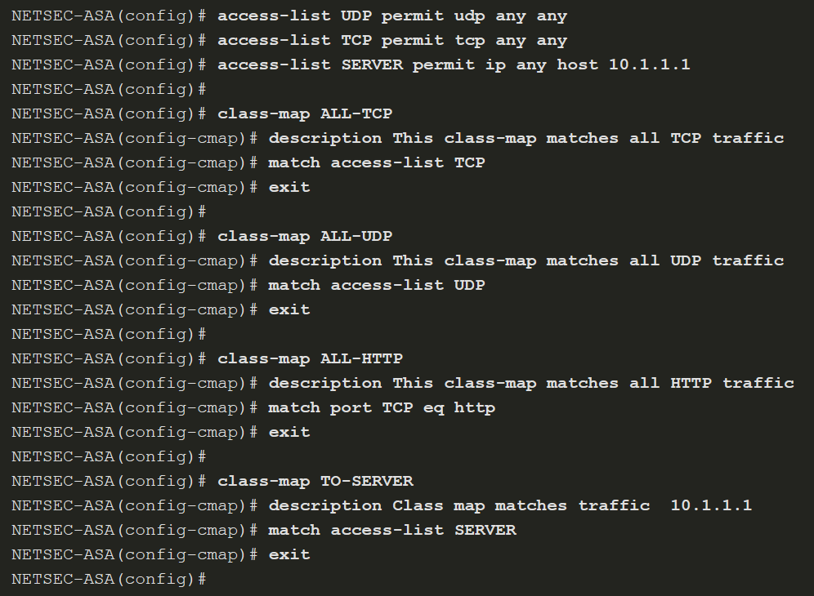
Service Policies on an ASA
Configure Class Maps
To create a class map and enter class-map configuration mode, use the class-map class-map-name global configuration mode command.
Next, traffic to match should be identified using the match any (matches all traffic) or match access-list access-list-name commands to match traffic specified by an extended access list.
Notes:
21: ASA Firewall Configuration 21.7: Service Policies on an ASA 21.7.2: Configure Class Maps

Slide 90
Service Policies on an ASA
Define and Activate a Policy
Use the policy-map policy-map-name global configuration mode command, to apply actions to the Layer 3 and 4 traffic.
In policy-map configuration mode, config-pmap, use the following commands:
description - Add description text.
class class-map-name - Identify a specific class map on which to perform actions.
These are the three most common commands available in policy map configuration mode:
set connection - Sets connection values.
inspect - Provides protocol inspection servers.
police - Sets rate limits for traffic in this class.
To activate a policy map globally on all interfaces or on a targeted interface, use the service-policy policy-map-name [ global | interface intf ] global configuration mode command to enable a set of policies on an interface.
Notes:
21: ASA Firewall Configuration 21.7: Service Policies on an ASA 21.7.3: Define and Activate a Policy
21.7.4: Syntax Checker - Define and Activate a Policy

Slide 91

Service Policies on an ASA
Define and Activate a Policy (Cont.)
The example configures the policy map. Its associated service policy is applied globally.
Notes:
21: ASA Firewall Configuration 21.7: Service Policies on an ASA 21.7.3: Define and Activate a Policy
21.7.4: Syntax Checker - Define and Activate a Policy

